Slide 1
IXP discussion Panel
SEE6 Budva / Montenegro
June 2017

Slide 2
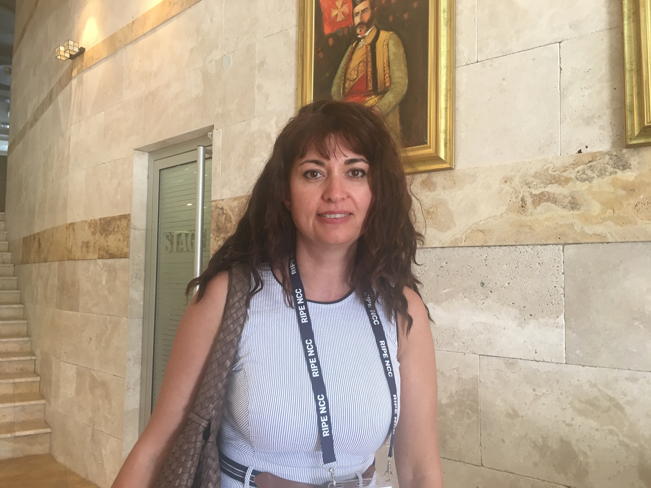
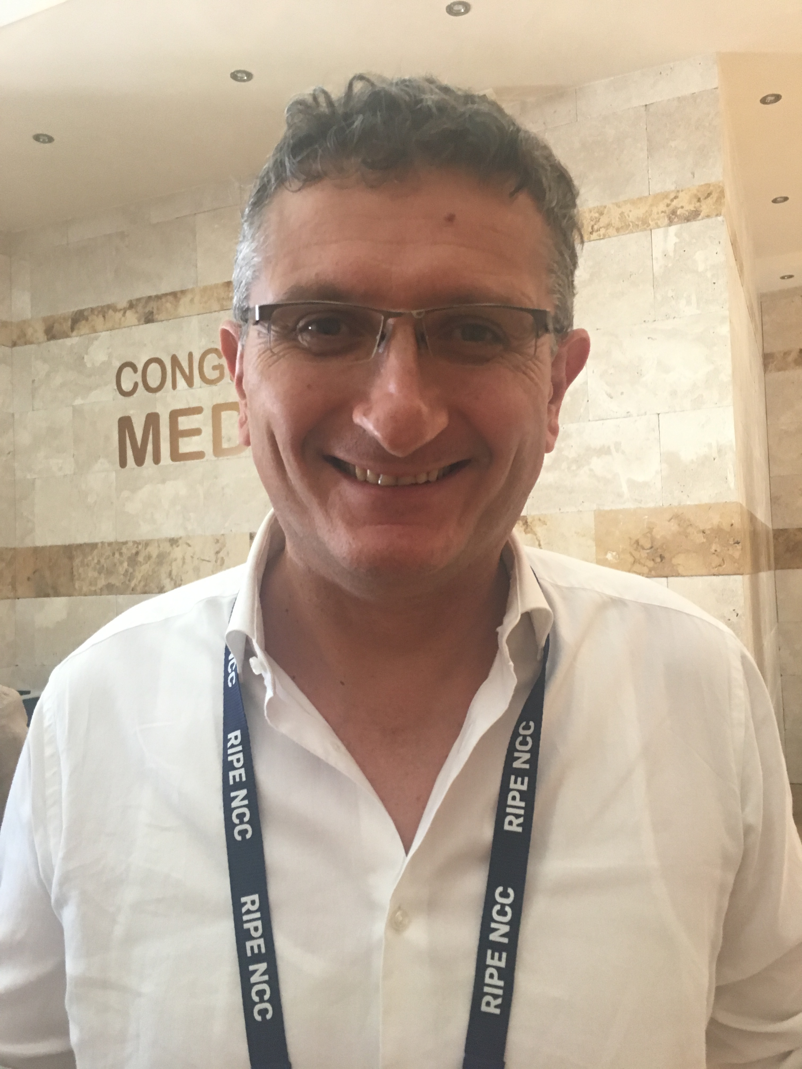
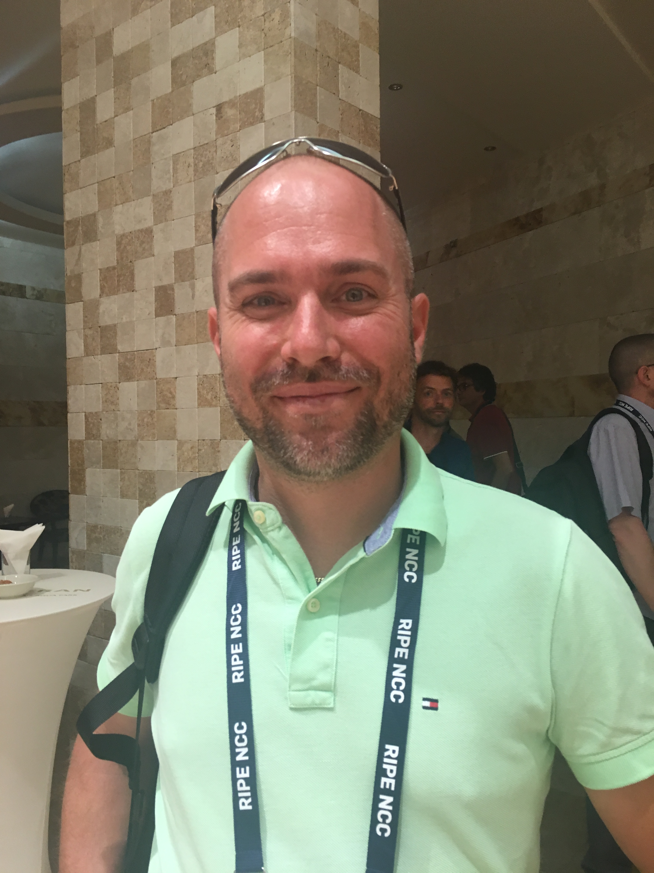
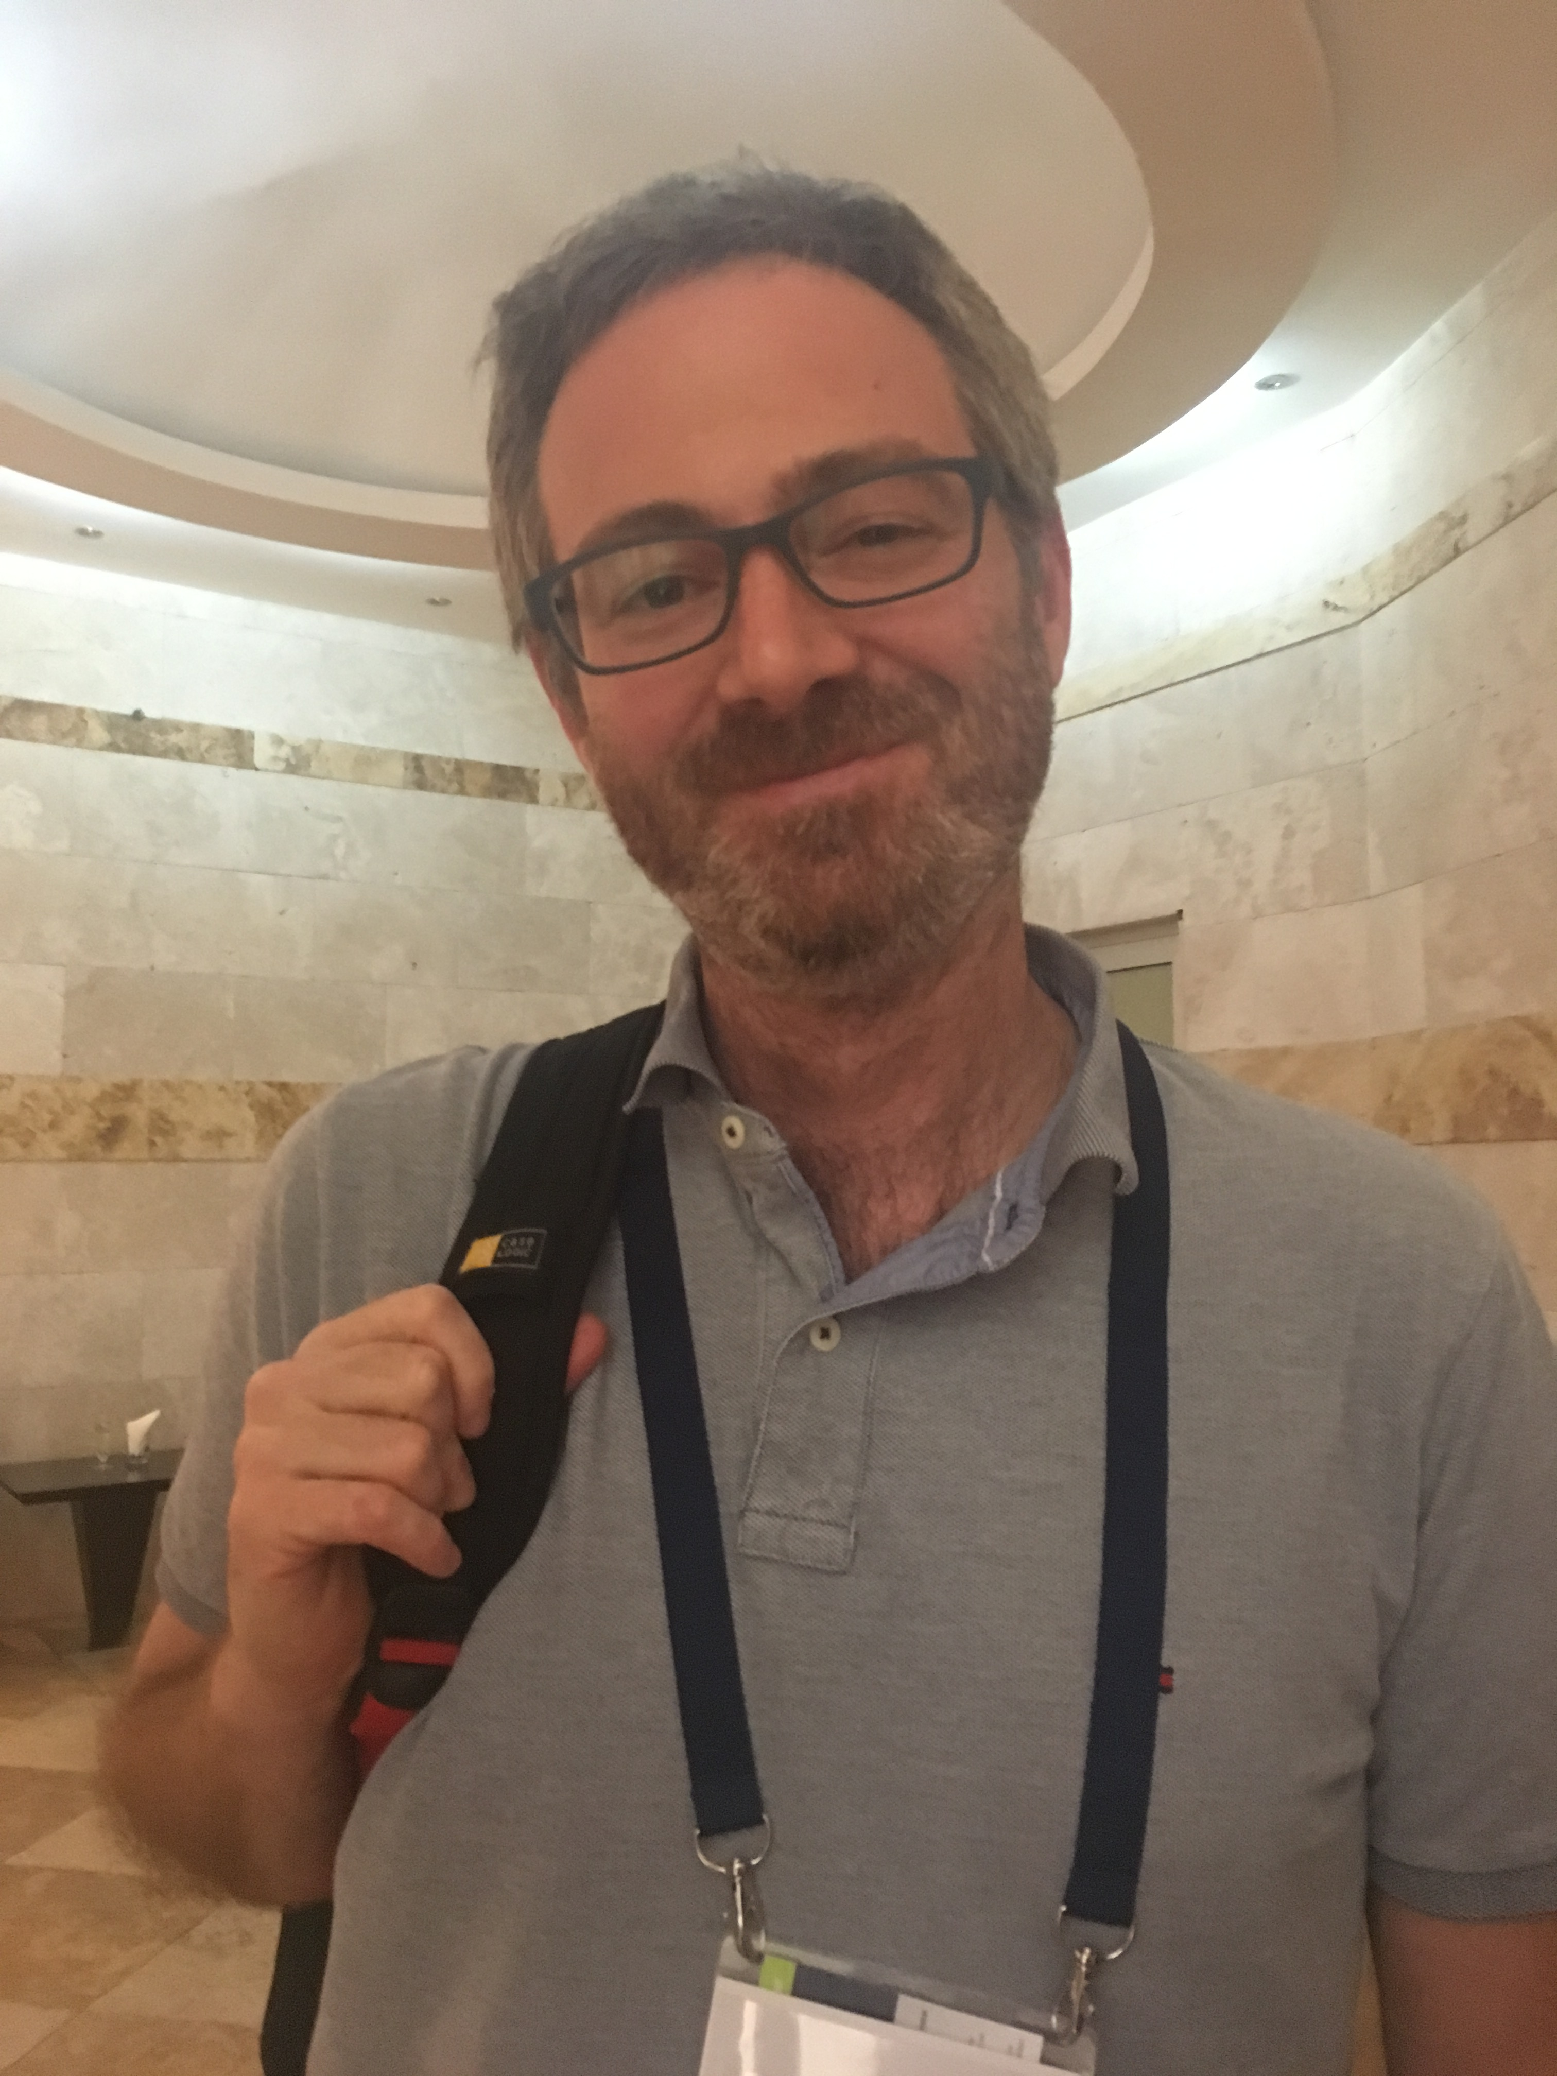
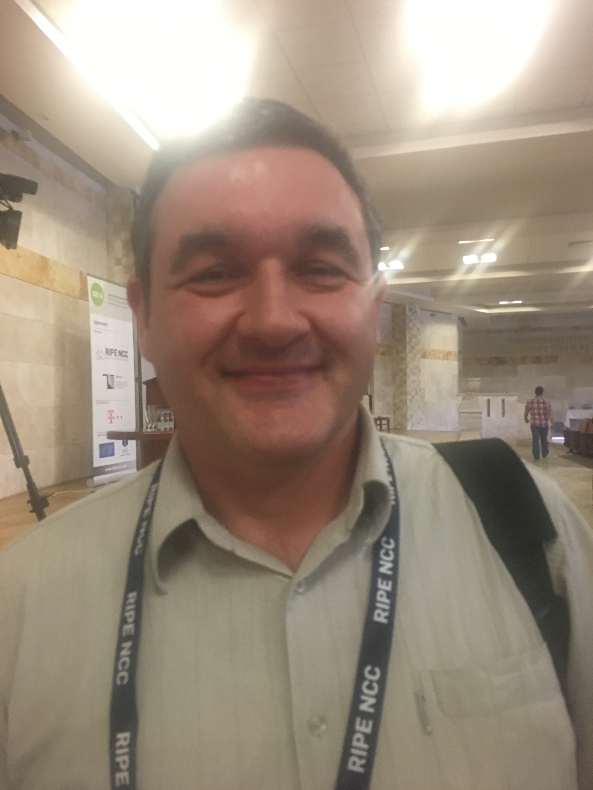
IXP Panelist
Angela Stanescu
InterLAN
Bozo Krstajic
MIXP
Martin Semrad
NIX.cz
Daniele Arena
NaMeX
Nenad Kranjnovic
SOX

Slide 3
Thank you

