Slide 1
Neutral IXP in Albania
An Ongoing Initiative
Arjan Xhelaj – RASH
Daniele Arena – NaMeX

Slide 2
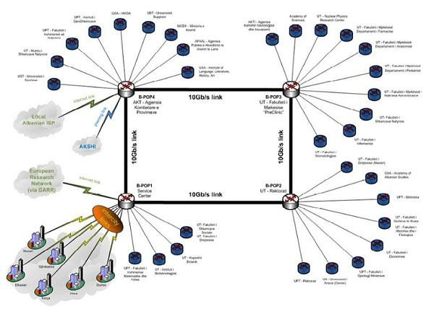
About RASH
Albanian NREN
Founded in 2012
Mission:
Connect Albanian public universities to GEANT and to the Internet
Provide services to universities
Software for administration, accounting, HR
Portals for professors and students

Slide 3
About NaMeX
Neutral, non-profit, member-based IXP
Based in Rome, Italy
Founded in 1995, established as a consortium in 2001
74 members
National/International carriers
CDNs/OTT
Local ISPs
NREN and NGOs
Public peering, colocation and meet-me room
~40Gbps publicly exchanged traffic
Second largest IXP in Italy
Mission: To promote and facilitate the interconnection of networks and networking communities

Slide 4
Where does local Albanian traffic go?
Shkodër to Tirana: 70 km
Traceroute:
Athens
London
Amsterdam
Hamburg
Prague
Bratislava
Budapest
Belgrade
Podgorica
RTT: 108.7 ms
(Made with RIPE Atlas)

Slide 5
Where does local Albanian traffic go?
Kukës to Tirana: 100 km
Traceroute:
Vienna
Bratislava
Budapest
Belgrade
Podgorica
RTT: 33.7 ms
(Made with RIPE Atlas)

Slide 6
Where does local Albanian traffic go?
Albanian-language traffic includes Kosovo
Prishtina to Tirana: 185 km
Traceroute:
Milan
Frankfurt
Munich
Vienna
Sofia
Skopje
RTT: 71.3 ms
(Made with RIPE Atlas)

Slide 7
Where does local Albanian traffic go?
A map of traceroutes between Atlas probes in Albania (courtesy ixp-country-jedi)

Slide 8
Albanian ISP/Internet Situation
Albania is an ISP-rich environment: 51 ASNs
Comparison: 36 MK, 14 ME, 145 GR, 151 RS
661 IPv4 Routes
33 IPv6 Routes
39 ASNs with no peering to speak of
i.e. 3 IPv4 “adjacencies” (i.e. peerings + transits) or less
77% of total
Only 6 with 7+ adjacencies (i.e. “active” peering)
About 17,000 .al domains registered
Most local-content websites are hosted abroad
None of the top 20 Albanian sites is hosted inside the country
(Sources: HE, DomainTools, Alexa)

Slide 9
Why is Albanian content hosted abroad?
Scarce peering environment
Easier to reach servers abroad
Focus on transit, not peering

Slide 10
IXP in Albania
One existing IXP: ALB-IX
A service of ALBtelecom (the incumbent)
8 customers
Main drawback: lack of trust of ISPs in the incumbent
Competitor, non-neutral
We are building a neutral IXP in Tirana
Management: RASH supported by NaMeX
Guaranteed neutrality & experience
Participation:
Several Albanian ISPs are already willing to get started
Ongoing talks with more ISPs and foreign CDNs and OTTs
Equipment: initially donations
Location: RASH Data Center

Slide 11
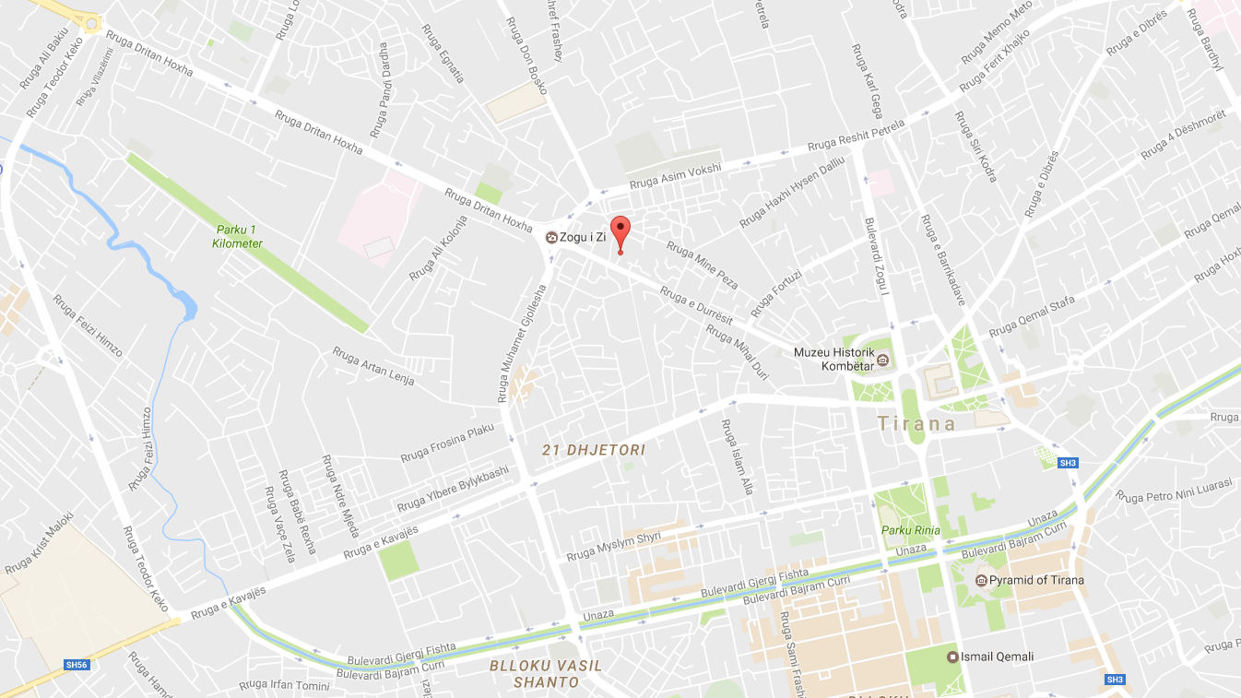
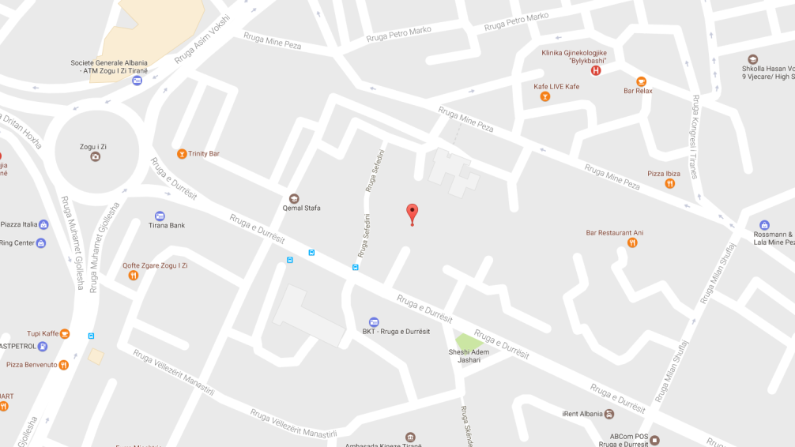
Data Center: Location
Rruga e Durrësit (road from center to airport), next to school «Qemal Stafa»

Slide 12
Data Center Features
Two separate rooms already structured
Server room
Carrier / meet-me room
N+1 UPS
Generator
On-site network engineers
ATU fiber delivered on-site
Possibility of other fiber access
Location close to main metropolitan fiber networks
Possibility of separate fiber access from rear street

Slide 13
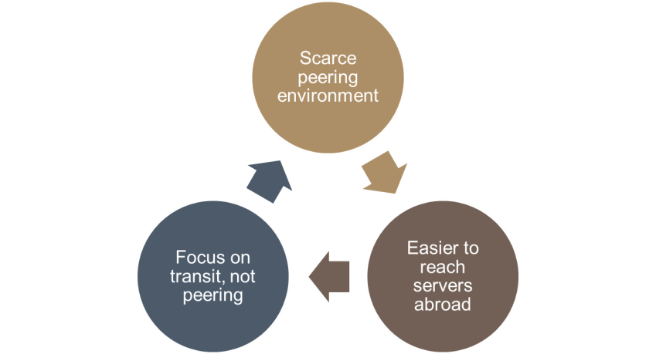
Our goals
Keep local traffic local
Stop long traces and high RTTs!
Promote locally hosted content
Be a catalyst for the development of an ISP community in Albania
Neutral IXP
Network Operators Group
ISP Association
We are planning to have an ISP meeting in Sep/Oct in Tirana
Launch the IXP
Light the first spark for NOG and ISPA
We are getting a lot of external support
RIPE NCC
ISOC
If you are an Albanian ISP, come talk to us!

Slide 14
Q&A
Arjan Xhelaj – arjanxhelaj@rash.al
Daniele Arena – d.arena@namex.it

