Slide 1
Agency for Electronic Communications and Postal Services
Pavle Mijuskovic, Deputy Executive Director

Slide 2
Content
About Montenegro
About Agency
Overview of electronic comunications market
Achieved in 2016

Slide 3
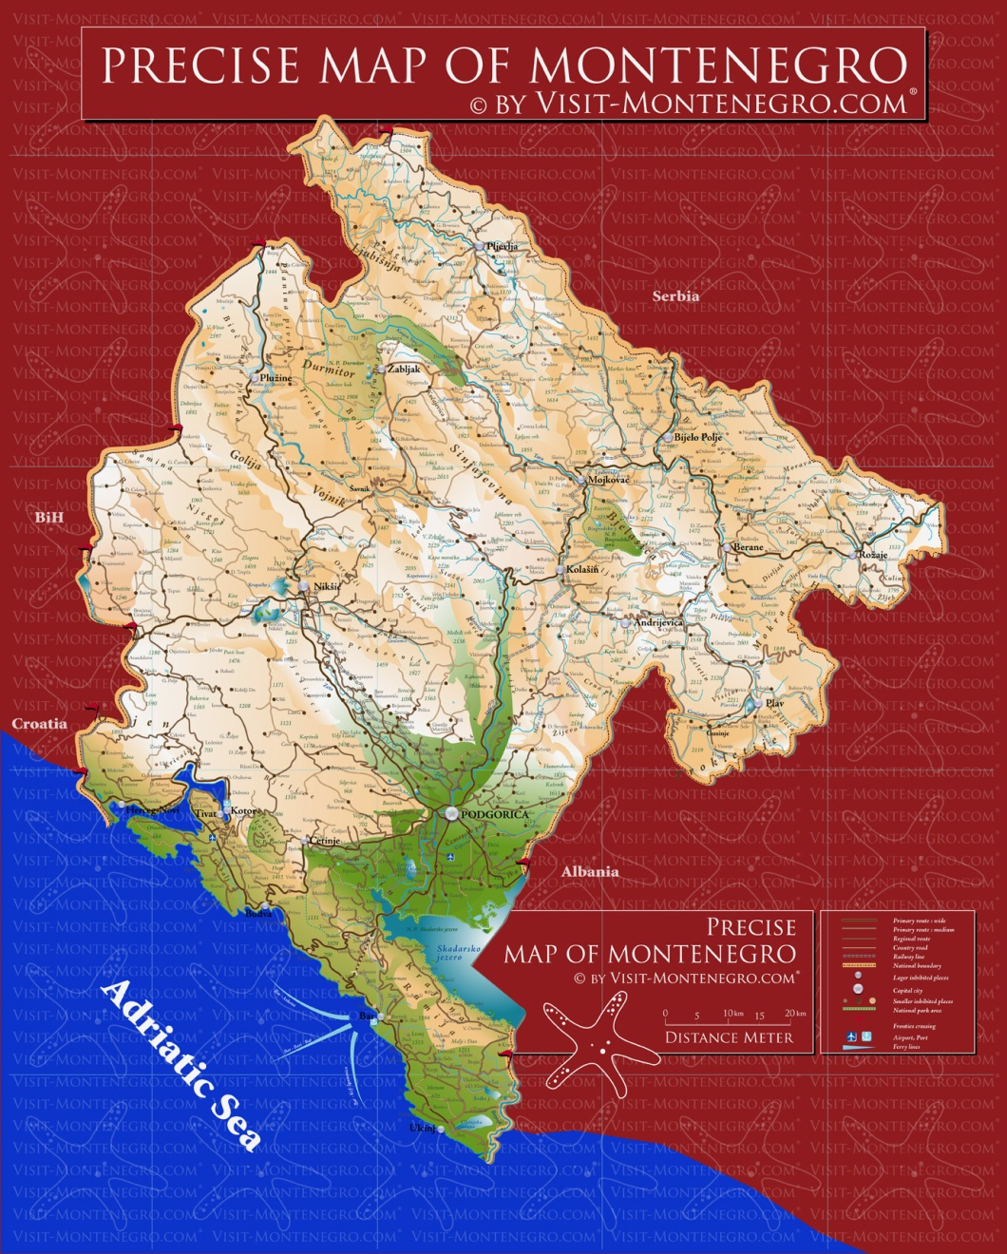
About Montenegro
Montenegro- basic data:
area - 13.812 km² population – 620,029 seacoast - 294 km, beaches - 73 km highest mountain - 2.522 m (Durmitor, Bobotov kuk) Capital and Administrative Center: Podgorica (185,937 citizens)
Ports : Bar, Budva, Kotor and Herceg Novi
Airports :Podgorica and Tivat

Slide 4
About Agency
The Agency for Electronic Communications and Postal (EKIP) was established on 8 March 2001
Our goals:
to provide secure and predictable environment;
to create conditions for the implementation and development of new technologies, with the promotion of rational utilization of limited resources;
to promote competition and prevent the distortion of market;
to resolve disputes between operators, and to constantly improve the protection of the interests of customers.

Slide 5
About Agency
Managing bodies of the Agency are the Council and the Executive Director
There is 70 employees in the Agency, including the President, the Council members and the Executive Director.

Slide 6
Overview of electronic comunications market
40 – registered operators
4 – fixed operators
3 – mobile operators
16 – ISP
7 – AVM (TV programs distribution) operators
Sector revenue ca 231 mil
Investment ca 117 mil

Slide 7
Fixed telephony
Subscribers 149.412
Penetration 24,1%

Slide 8
Mobile telephony
Subscribers 1.020. 768
Penetration 165%

Slide 9
Broadband Internet access
Fixed BB subscribers 114.917
Fixed penetration 18,5%
Mobile penetration 8,9%
Household penetration 58,9%
Internet usage 69,9%

Slide 10
AVM (TV programs distribution)
Subscribers 189.358

Slide 11
Achieved in 2016
Spectrum auction
System for data collection
Infrastructure mapping
Tariff Calculator
Roaming agreement
Price reduction

Slide 12
Pavle Mijuskovic
Deputy Executive Director
pavle.mijuskovic@ekip.me

