Slide 1
Montenegro Internet eXchange Point (MIXP) – a success story
Prof. Božo Krstajić, PhD
MIXP - University of Montenegro
www.mixp.me

Slide 2
Content
Short history of the MIXP establishing
Members
Plans
Conclusion

Slide 3
The MIXP history
Montenegro was one of the last countries in Europe without an Internet exchange point
Agency for Electronic Communications and Postal Services has started some activities to promote an IXP building at the end of 2013.
CIS UoM produced the Feasibility Study on the Establishment of Internet Exchange Point (IXP) in Montenegro on April 2014. and validated through many public debates and events (INFOFEST 2014).

Slide 4
The MIXP history
The analysis of profiles of the existing ISPs in Montenegro and potential candidates for the first IXP in Montenegro, as well as the fact that the national, strategic and security reasons take precedence over the commercial reasons, FS proposed that the academic environment (University of Montenegro) supported by the Ministry and the Agency is the optimum solution for establishing the first IXP on non-profit base.

Slide 5
The MIXP history
Based on FS, the Ministry of Information Society and Telecommunications prepared the information and recommendation for the Government of Montenegro, and the Government has made the Decision at November 2014. to make in the CIS UoM the first national IXP.
The technical team of the CIS UoM with SOX help has created the detailed specifications of the equipment and activities necessary for the technical part of installing the IXP.

Slide 6
Recommended technical solution
MIXP based on Ethernet, using route-server model, as a separate AS with a unique ASN and IPv4 and IPv6 addresses

Slide 7
The MIXP history
Since ISOC and ITU have showed great interest and have expressed the readiness to help on installing the first IXP, we have contacted their representatives and organized a comprehensive workshop (part of 20th international scientific conference IT 2015 in Žabljak) which gave the final design to the IXP.
The three-day workshop has gathered the representatives of RIPE, ICANN, France-IX, INEX, SOX, NIX.CZ, CISCO, CIS UoM, the Ministry, the Agency and the local ISPs.
July 2015 is apointed as the deadline by when the IXP in Montenegro to be established.

Slide 8
The MIXP history
We had to:
Prepare location (CIS data center),
Provide required infrastructure (telecommunication, power supply, cooling, ..)
Procure the equipment (route server, switches, IXP manager servers, ..)
Set-up and configure equipment
Make organization structure and rules
Promote the IXP (MIXP) and offer services

Slide 9
The MIXP history
Telenor and Crnogorski Telekom have truly made an effort to help on the installation of the first IXP and have agreed to together procure all equipment for MIXP infrastructure.
CIS UoM prepared location in data center and the resources for the implementation of necessary infrastructural changes (the network and power installation) have come from the ITU which helping the development of the IXP in Montenegro.
Agency for Electronic Communications and Postal Services support MIXP for staff development and trainings (NIX.CZ provided the training for BGP peering)
ISOC will provide switch for redundance soon.

Slide 10
The MIXP history
May 2015.
www.mixp.me
RIPE has assigned ASN, IPv4 and IPv6 addresses
Jun 2015.
The location has been prepared
The equipment has been bring in the place

Slide 11
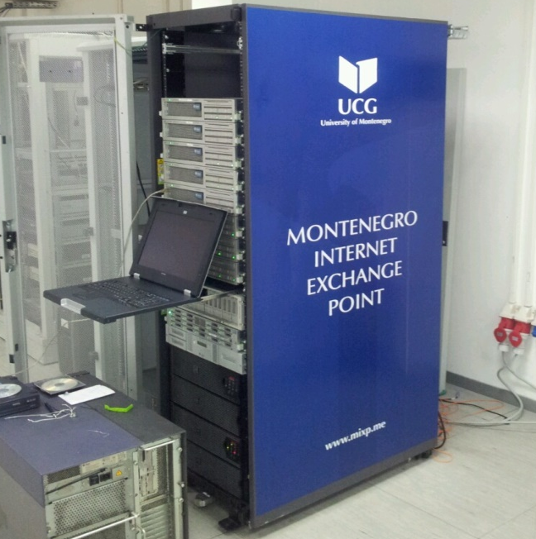
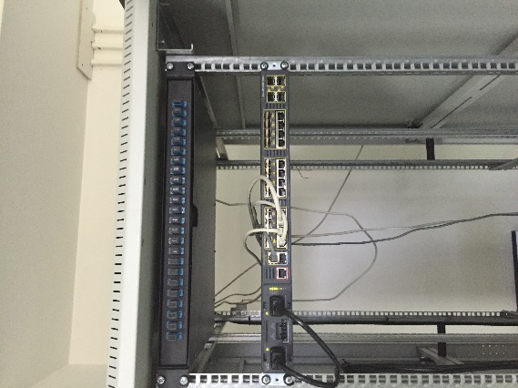
The MIXP history
6th July 2015. – configuration of the MIXP was completed and two ISPs were connected to it (doMen and University of Montenegro).

Slide 12
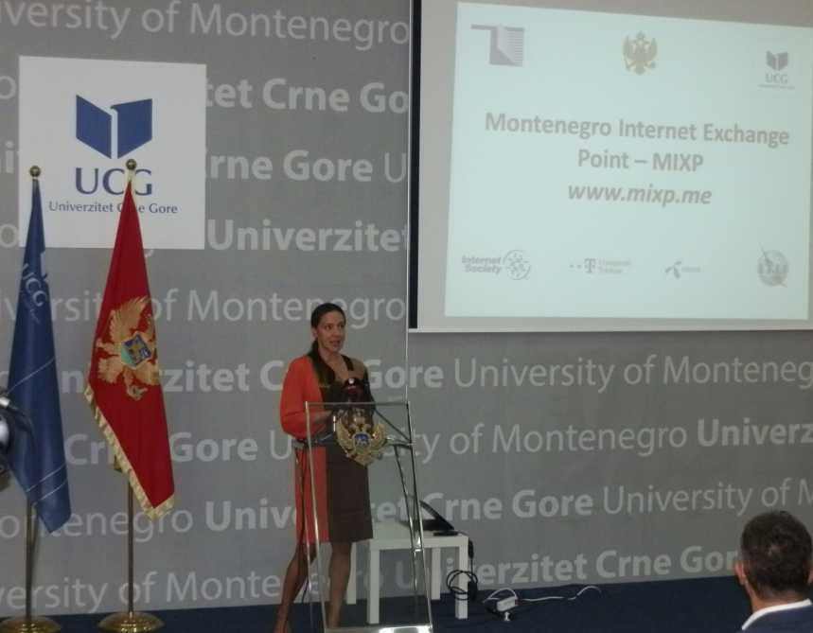
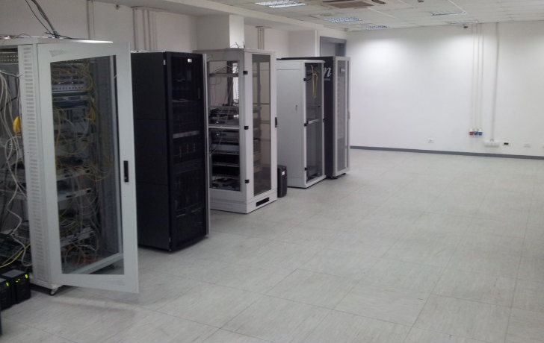
The MIXP history
The opening ceremony of the MIXP took place on 22.07. 2015.

Slide 13
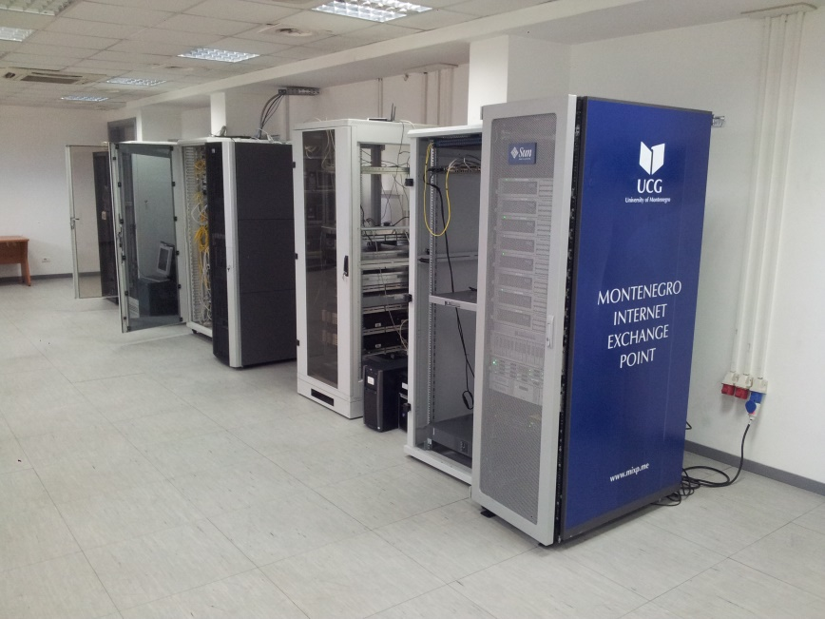
MIXP - synergy
There was the synergic effect of cooperation between the CIS UoM, the Ministry, the Agency, ITU, ISOC, RIPE, ICANN, CISCO, France–IX, INEX, SIX, NIX.CZ, SOX and local ISPs (Telekom CG and Telenor).

Slide 14
The MIXP history
Promotional work of the MIXP was until 01.01.2016.
It is characterized by a promotion of the IXP’s functionality and advantages through a call to all ISPs and other legal subjects which fulfill the conditions of connecting to connect to the MIXP, and the services of monthly use of the MIXP was not be charged.

Slide 15
The MIXP history
The government of Montenegro established the advisory board 21.09.2015.
The management board of UoM approved MIXP rules and price list, which proposed the advisory board, on December 2015.
MIXP started 01. 01.2016.

Slide 16
MIXP – advisory board
The board is composed of representatives from:
MIXP,
Agency for Electronic Communications and Postal Services,
Ministry for Econommy and
Operators (ISPs or MIXP members) using the IXP services.

Slide 17
MIXP – services
Peering (10/100 Mbps and 1 Gbps)
Route server (bird with BGP)
DNS resolving (F-root, 192.5.5.241)
Looking glass (view routing information)
Peering matrix (who is interconnected to whom)
Traffic monitoring (IXP manager)

Slide 18
MIXP – members
Connected: UCG, CG Telekom, Telenor, Mtel, MNnews (Top three local ISPs)
Ongoing: The Government network, and Telemach
Negotiation: Orion, ...
Traffic growing ...

Slide 19
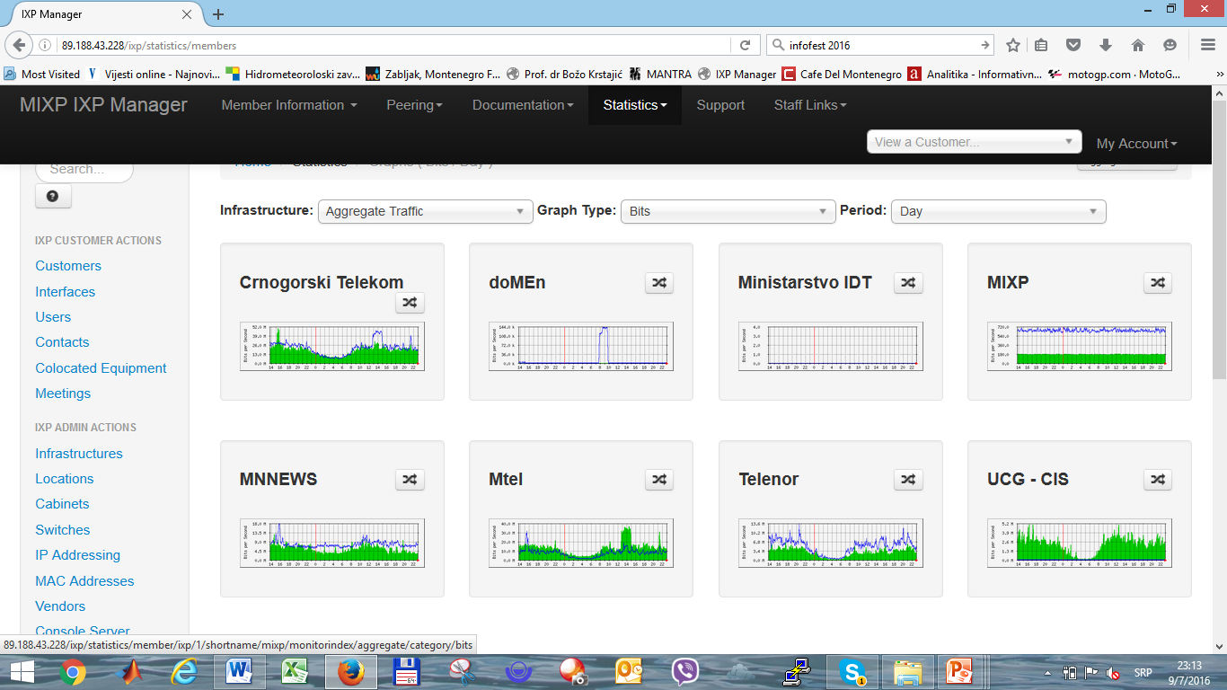
MIXP – traffic

Slide 20
MIXP – benefits
Accelerates local internet exchanges between ISPs
Improve security of local communications
Reduces latency
Improves overall bandwidth
Improves the routing efficiency
Relieve links for global Internet access,
Improve the quality of Internet access services
Help technological start-ups and develop relationships with research and training organizations

Slide 21
MIXP – plans
Connect all local ISPs.
Establishing an association of MIXP members.
Introduction of new services.
Caching global services and contents most commonly used in the local community within the IXP

Slide 22
MIXP – plans
Connecting with the neighboring IXPs (SOX)
Connecting with more significant global ISPs

Slide 23
CONCLUSION
MIXP was established in the right way and thanks to the synergy of the considered participants, but should continue to be developed with the active participation of all stakeholders and trends of ICT development.

Slide 24
Thank you !

