Slide 1
DANE/DNSSEC/TLS Testing in the Go6lab
Jan Žorž, ISOC/Go6 Institute, Slovenia
jan@go6.si
zorz@isoc.org

Slide 2
Acknowledgement
I would like to thank Internet Society to let me spend some of my ISOC working time in go6lab and test all this new and exciting protocols and mechanisms that makes Internet a bit better and more secure place…

Slide 3
DNSSEC implementation in go6lab
Powerdns server (used as primary for non-signed domains) as “hidden” primary DNS server
OpenDNSSEC platform for signing domains
BIND9 DNS servers as secondaries to OpenDNSSEC to serve signed zones
Virtualization used: PROXMOX 3.4
OS templates: fedora-20, Centos6/7

Slide 4
DNSSEC implementation in go6lab
“Bump in a wire”
Two public “primary” servers
Concept:

Slide 5
DNSSEC in go6lab
That was fairly easy and it works very well.
Implementation document used from Matthijs Mekking:
http://go6.si/docs/opendnssec-start-guide-draft.pdf

Slide 6
DANE experiment
When DNSSEC was set up and functioning we started to experiment with DANE (DNS Authenticated Name Entities).
Requirements:
DNSSEC signed domains
Postfix server with TLS support > 2.11
We decided on Postfix 3.0.1

Slide 7
DANE
TLSA record for mx.go6lab.si
_25._tcp.mx.go6lab.si. IN TLSA 3 0 1 B4B7A46F9F0DFEA0151C2E07A5AD7908F4C8B0050E7CC25908DA05E2 A84748ED
It’s basically a hash of TLS certificate on mx.go6lab.si
More about DANE:
http://www.internetsociety.org/deploy360/resources/dane/

Slide 8
What is DANE and how does it work

Slide 11
DANE verification
Mx.go6lab.si was able to verify TLS cert to T-2 mail server and nlnet-labs and some others…
mx postfix/smtp[31332]: Verified TLS connection established to
smtp-good-in-2.t-2.si[2a01:260:1:4::24]:25: TLSv1 with cipher
DHE-RSA-AES256-SHA (256/256 bits)
dicht postfix/smtp[29540]: Verified TLS connection established to
mx.go6lab.si[2001:67c:27e4::23]:25: TLSv1.2 with cipher
ECDHE-RSA-AES256-GCM-SHA384 (256/256 bits)

Slide 12
Postfix config
smtpd_use_tls = yes
smtpd_tls_security_level = may
smtpd_tls_key_file = /etc/postfix/ssl/server.pem
smtpd_tls_cert_file = /etc/postfix/ssl/server.pem
smtpd_tls_auth_only = no
smtpd_tls_loglevel = 1
smtpd_tls_received_header = yes
smtpd_tls_session_cache_timeout = 3600s
smtp_tls_security_level = dane
smtp_use_tls = yes
smtp_tls_note_starttls_offer = yes
smtp_tls_loglevel = 1
tls_random_exchange_name = /var/run/prng_exch
tls_random_source = dev:/dev/urandom
tls_smtp_use_tls = yes

Slide 13
Malformed TLSA record
We created a TLSA record with a bad hash (one character changed)
Postfix failed to verify it and refused to send a message
mx postfix/smtp[1765]: Untrusted TLS connection established to
mail-bad.go6lab.si[2001:67c:27e4::beee]:25: TLSv1.2 with
cipher ECDHE-RSA-AES256-GCM-SHA384 (256/256 bits)
mx postfix/smtp[1765]: 3A4BE8EE5C: Server certificate not trusted

Slide 14
1M top Alexa domains and DANE
We fetched top 1 million Alexa domains and created a script that sent an email to each of them ( test-dnssec-dane@[domain] )
After some tweaking of the script we got some good results
Then we built a script that parsed mail log file and here are the results:

Slide 15
Results
Out of 1 million domains, 992,232 of them had MX record and mail server.
Nearly 70% (687,897) of all attempted SMTP sessions to Alexa top 1 million domains MX records were encrypted with TLS
Majority of TLS connections (60%) were established with trusted certificate
1,382 connections where remote mail server announced TLS capability failed with "Cannot start TLS: handshake failure"

Slide 16
More results
TLS established connections ratios are:
Anonymous: 109.753
Untrusted: 167.063
Trusted: 410.953
Verified: 128
Quick guide: Anonymous (opportunistic TLS with no signature), Untrusted (peer certificate not signed by trusted CA), Trusted (peer certificate signed by trusted CA) and Verified (verified with TLSA by DANE).

Slide 17
DANE Verified
Verified: 128 !!!

Slide 18
Mail distribution
Mail Servers | # Domains Handled | TLS State
google.com | 125,422 | Trusted
secureserver.net | 35,759 | Some Trusted, some no TLS at all
qq.com | 11,254 | No TLS
Yandex.ru | 9,268 | Trusted
Ovh.net | 8.531 | Most Trusted, with redirect servers having no TLS at all

Slide 19
Mail distribution
Mail Servers | # Domains Handled | TLS State
Emailsrvr.com | 8,262 | Trusted
Zohomail.com | 2.981 | Trusted
Lolipop.jp | 1.685 | No TLS
Kundenserver.de | 2,834 | Trusted
Gandi.net | 2,200 | Anonymous

Slide 20
DNSSEC? DANE?
None of these “big” mail servers (and their domains) are DNSSEC signed (that meant no DANE for them possible up to January 2016).

Slide 21
When do DANE things fail?
Of course, with wrong certificate hash in TLSA record (refuses to send mail)
If domain where MX record resides is not DNSSEC signed (can’t trust the data in MX, so no verification)
If TLSA record published in non-DNSSEC zone (can’t trust the data in TLSA, so no verification)

Slide 22
When do things fail? (example)
go6lab.si zone is signed, so is mx.go6lab.si
there is TLSA for mx.go6lab.si, also signed
Domain signed.si is signed and MX points to mx.go6lab.si
Domain not-signed.si is not signed and MX points to mx.go6lab.si
We send email to jan@signed.si and jan@not-signed.si (signed.si and not-signed.si are used just as examples)

Slide 23
When do things fail? (example)
When I send email to jan@signed.si (signed domain): Verified TLS connection established to mx.go6lab.si[2001:67c:27e4::23]:25: When I send email to jan@not-signed.si (not signed domain): Anonymous TLS connection established to mx.go6lab.si[2001:67c:27e4::23]:25:

Slide 24
When do DANE verification also fail?
Let’s try to point MX record from signed domain to A/AAAA record in not-signed domain with TLSA that is also not signed (obviously) – mail.not-signed.si
Send mail to jan@signed.si when MX for signed.si points to mail.not-signed.si – DANE verification is not even started as chain of trust is broken

Slide 25
Postfix latest improvements ☺
postfix-3.1-20160103/HISTORY:
20160103
Feature: enable DANE policies when an MX host has a secure
TLSA DNS record, even if the MX DNS record was obtained
with insecure lookups. The existence of a secure TLSA record
implies that the host wants to talk TLS and not plaintext.
This behavior is controlled with smtp_tls_dane_insecure_mx_policy
(default: "dane", other settings: "encrypt" and "may"; the
latter is backwards-compatible with earlier Postfix releases).
Viktor Dukhovni.

Slide 26
Let’s Encrypt, DANE and mail
Let’s Encrypt recommends using ‘2 1 1’ and ‘3 1 1’ records
Validity of LE cert is 90 days
By default the underlying key is changed when renewing
…so also cert hash is changed
So, lot’s of work if you plan to publish 3 1 1 TLSA
using the ‘2 1 1’ method leads to another issue – namely lack of an DST Root CA X3 certificate in the fullchain.pem file provided by the Let’s Encrypt client
So we need to fetch the DST Root CA X3 certificate and add it to fullchain.pem file and verify that it did not change from previous time we renewed…

Slide 27
Script to add DST Root CA X3
lynx --source https://www.identrust.com/certificates/trustid/root-download-x3.html | grep -v "\/textarea" | awk '/textarea/{x=NR+18;next}(NR<=x){print}' | sed -e '1i-----BEGIN CERTIFICATE-----\' | sed -e '$a-----END CERTIFICATE-----\' >> /etc/letsencrypt/live/mx.go6lab.si/fullchain.pem

Slide 28
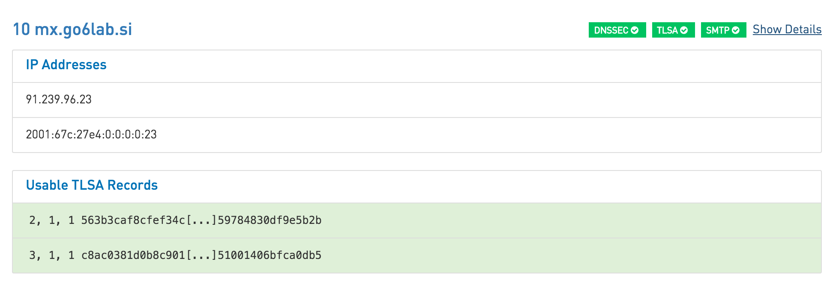
Valid 3 1 1 and 2 1 1 TLSA records

Slide 29
But…
At next certificate renew, by default underlying key will change and 3 1 1 TLSA record will become invalid…
Labor wise, we need to keep the underlying key through the renewals
--csr option in letsencrypt-auto client
In direcotry “examples” there is “generate-csr.sh” file

Slide 30
Stable underlying key…
./generate-csr.sh mx.go6lab.si
Generating a 2048 bit RSA private key
................+++
..+++
writing new private key to 'key.pem'
-----
You can now run: letsencrypt auth --csr csr.der

Slide 31
Renewals and hashes…
Now we are using the same underlying key for automatic renewals of certificate, so hash does not change and 3 1 1 TLSA record works.
We’ll rotate the underlying key when we decide to and being driven by human intervention (and also change the TLSA).
./letsencrypt-auto certonly -t --debug --renew -a standalone --csr ./mx.go6lab.si.der –keep
Of course, we add DST Root CA X3 certificate to fullchain.pem

Slide 32
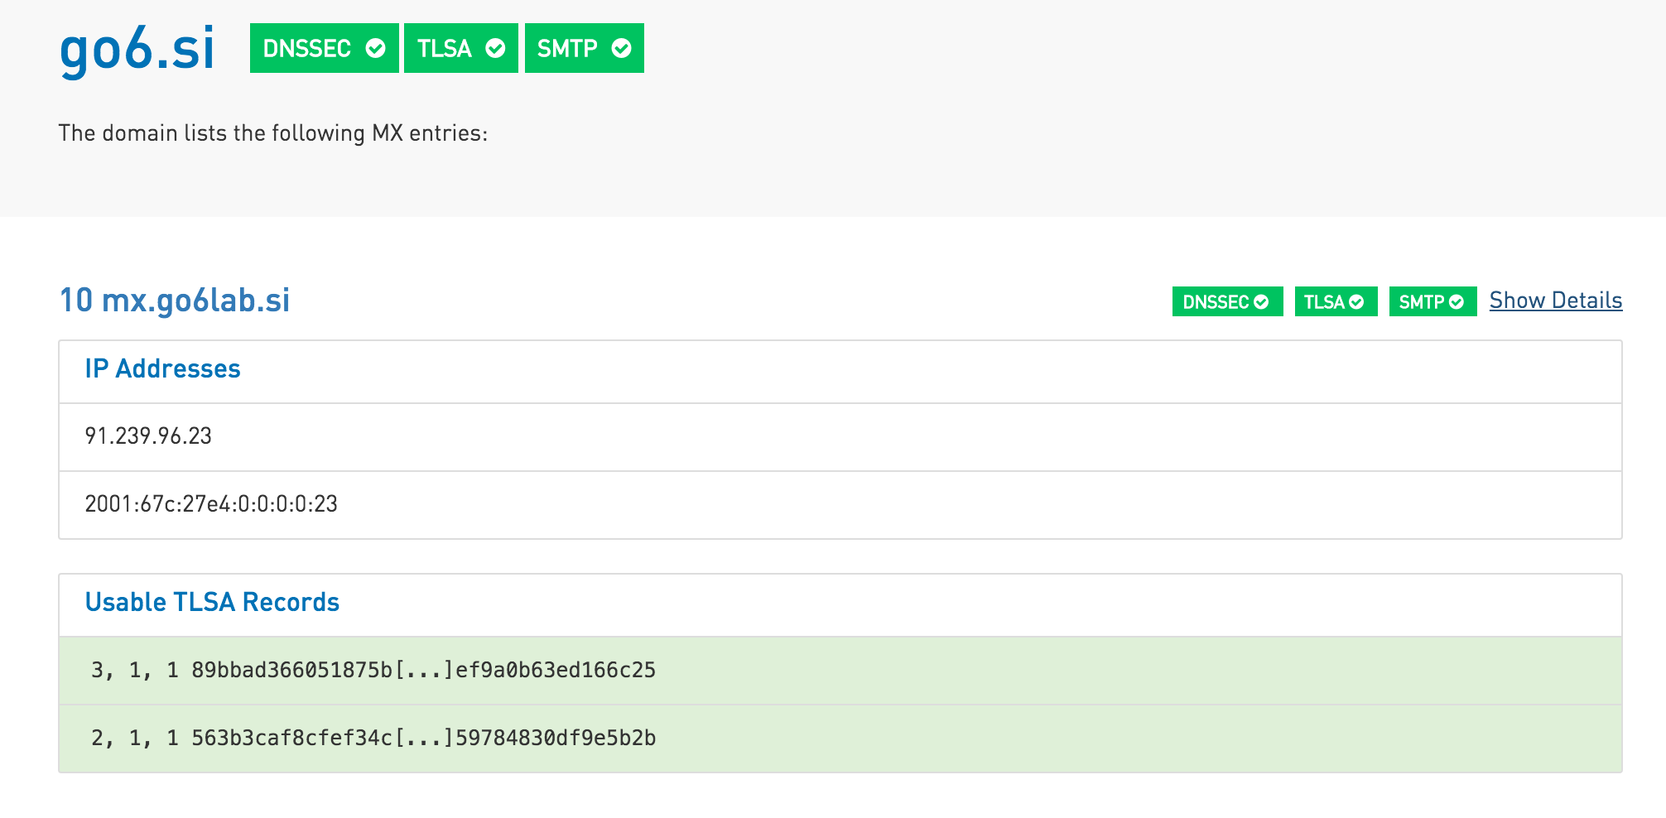

Slide 33
More reading:
http://www.internetsociety.org/deploy360/blog/2016/01/lets-encrypt-certificates-for-mail-servers-and-dane-part-1-of-2/
http://www.internetsociety.org/deploy360/blog/2016/03/lets-encrypt-certificates-for-mail-servers-and-dane-part-2-of-2/

Slide 34
Conclusions
70% of email can be encrypted in some way, you just need to enable TLS on your server
Low number of DNSSEC signed domains/servers
Even lower number of DANE/TLSA verified servers/connections
It’s easy, go and do it – it’s not the end of the world and it helps with verifying who are you sending emails to – and vice versa ;)

Slide 35
Conclusions II.
DANE verification failed (or was aborted) if DNSSEC chain of trust is not fully established and complete along the whole way.
TLSA in not-signed DNS zones would not help you much preventing your correspondents sending emails to server-in-the-middle (if you are not running latest bleeding edge development version of Postfix)
DNSSEC/DANE is easy, but please understand what are you doing before implementing it in production…

Slide 36
Q&A
Questions? Protests? Suggestions? Complaints?
jan@go6.si
zorz@isoc.org

