Slide 1
RIPE Slide Master

Slide 2
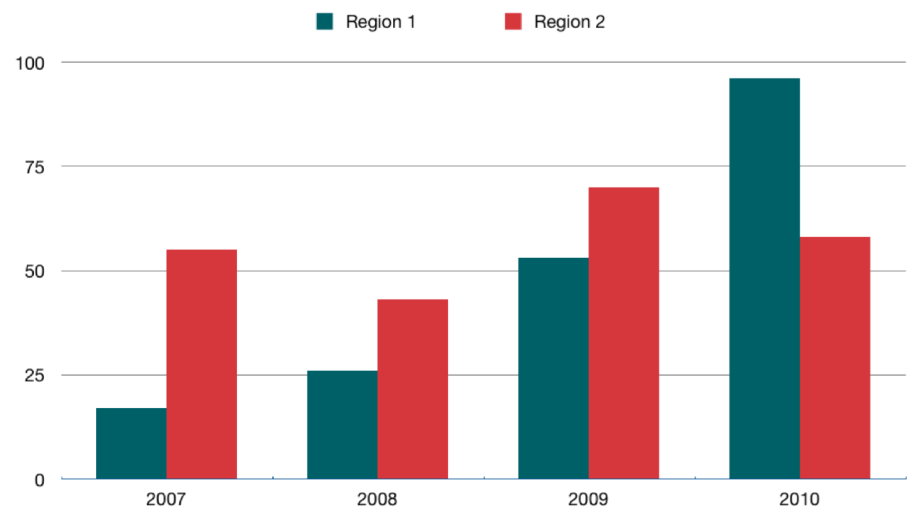
Bar

Slide 3
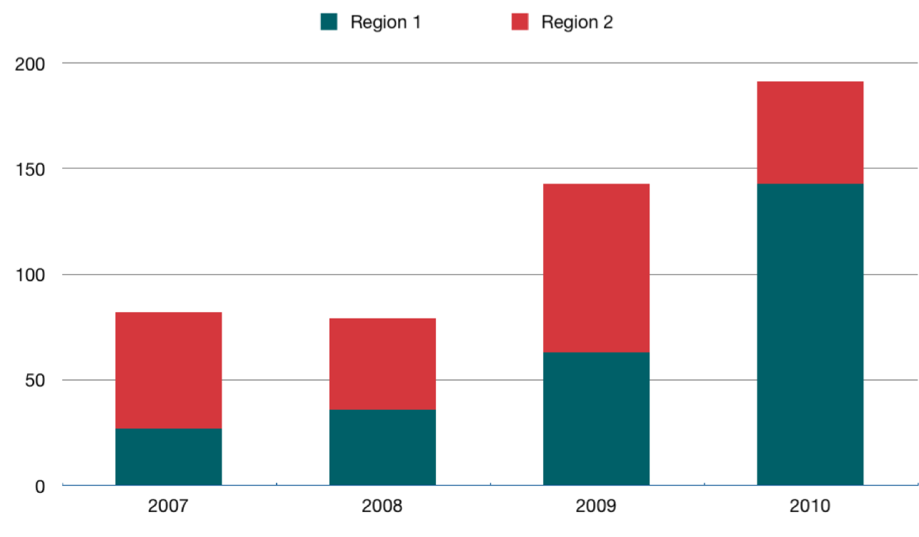
Stacked Bar

Slide 4
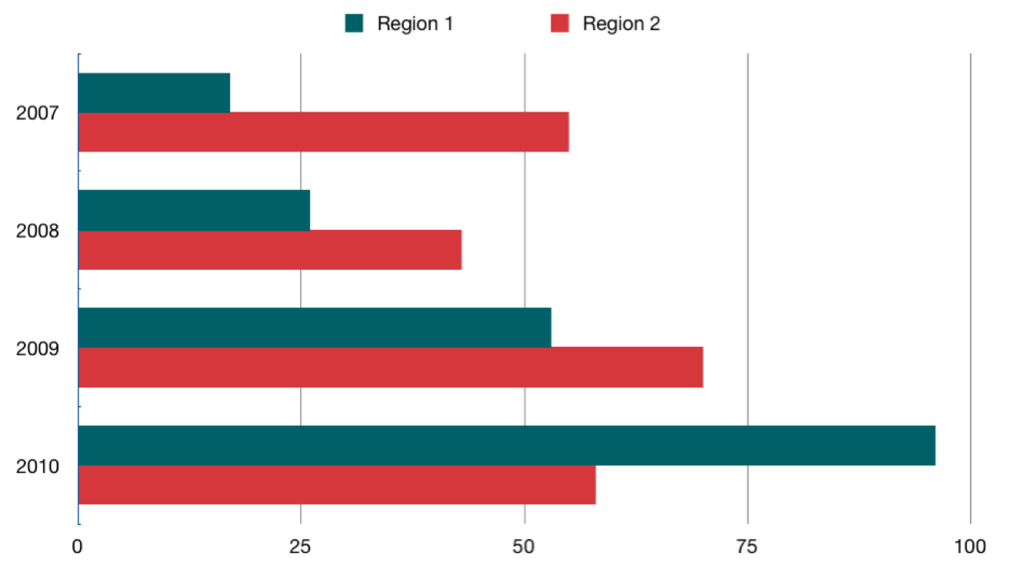
Horizontal Bar

Slide 5
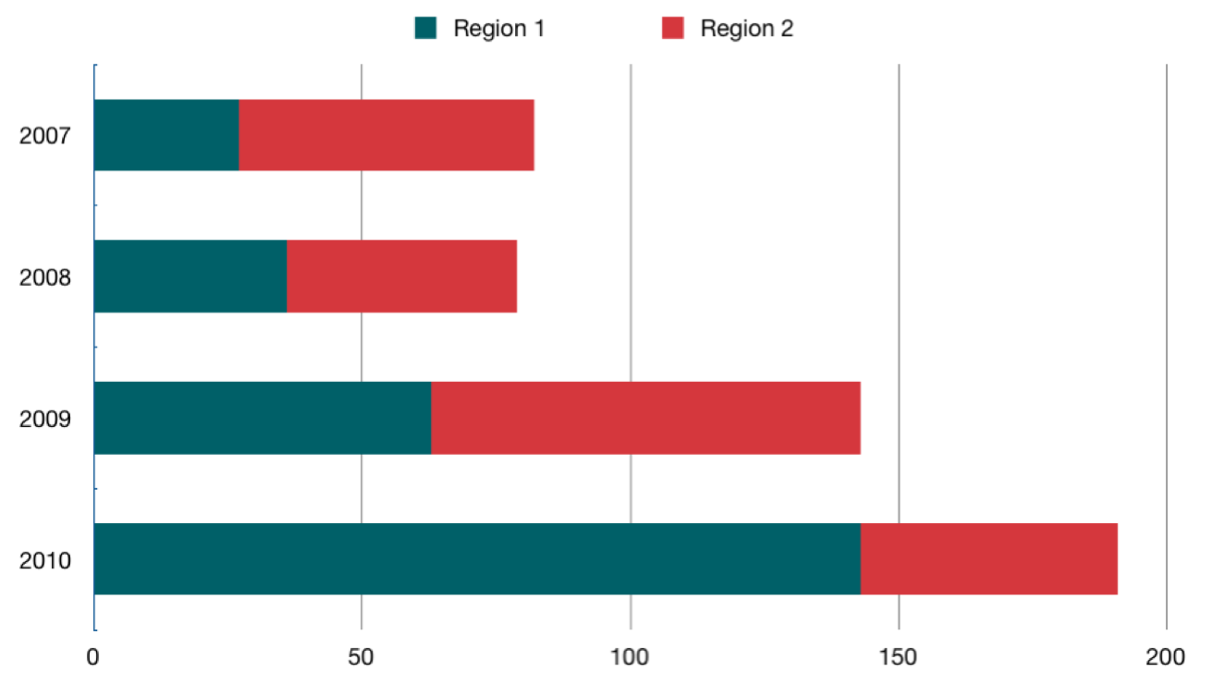
Stacked Horizontal Bar

Slide 6
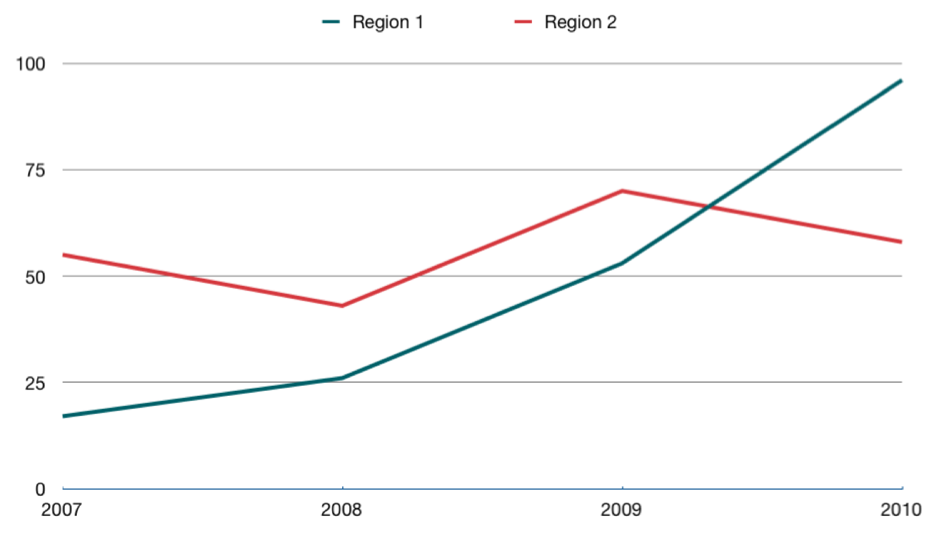
Line

Slide 7
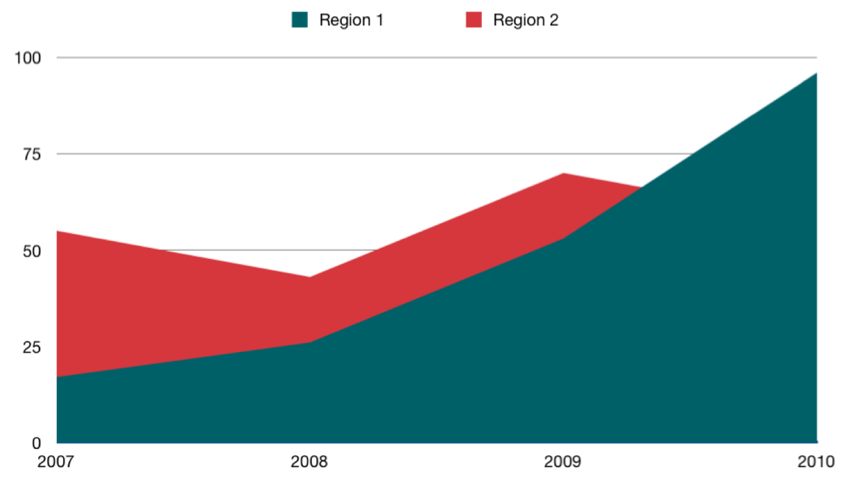
Area

Slide 8
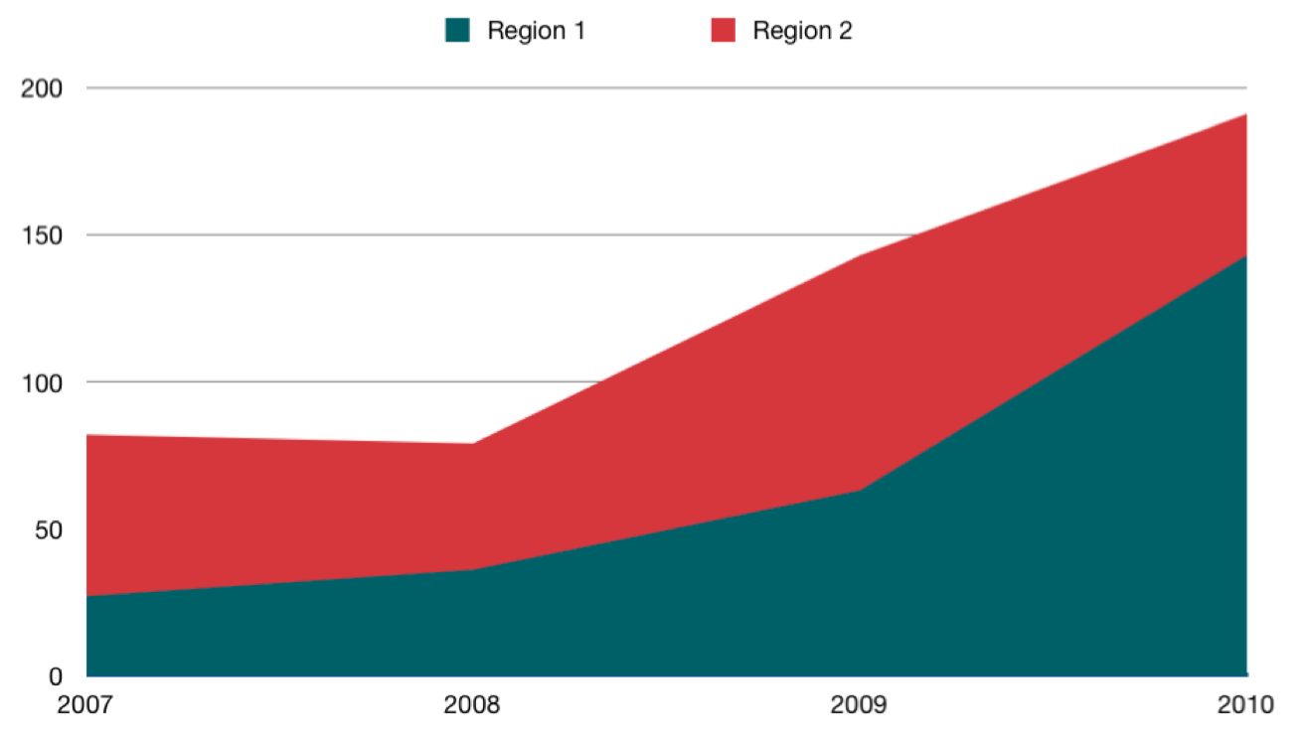
Stacked Area

Slide 9
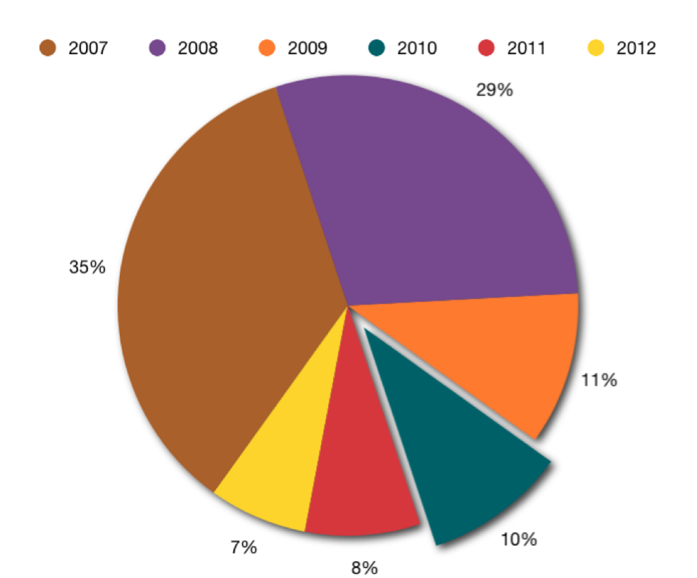
Pie

Slide 10
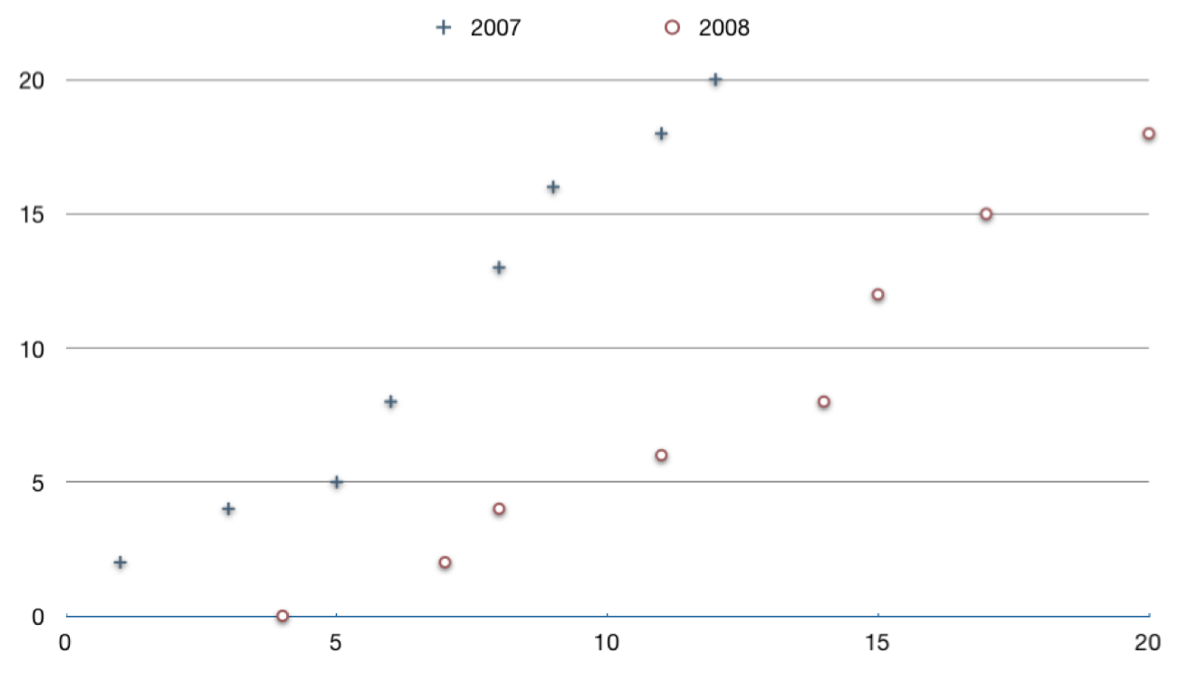
Scatter

Slide 11
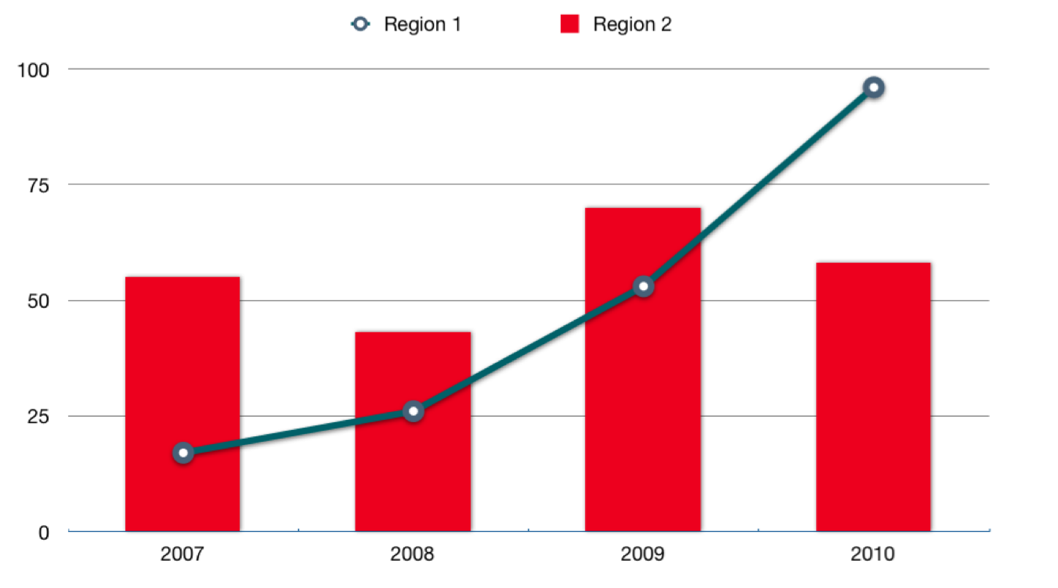
Mixed 1

Slide 12
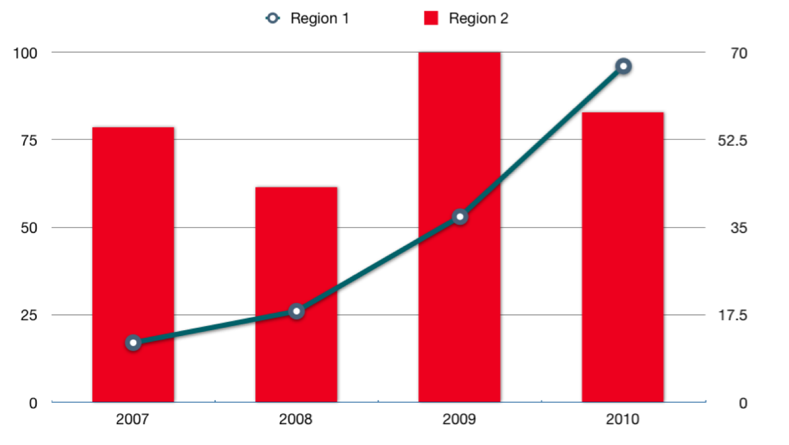
Mixed 2

Slide 13
Other Stuff
Default Text Box
Shapes
Table

