Slide 1
DDoS in Armenia - situation and how to handle it
Armen Manukyan, ABC Domain LLC

Slide 2
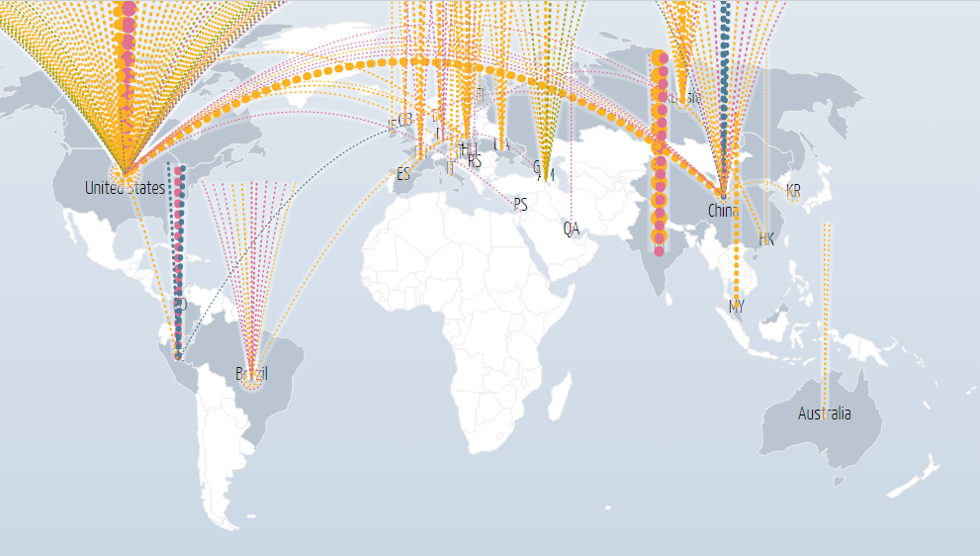
How it works?
<number>

Slide 3
DDoS history in Armenia
<number>

Slide 4
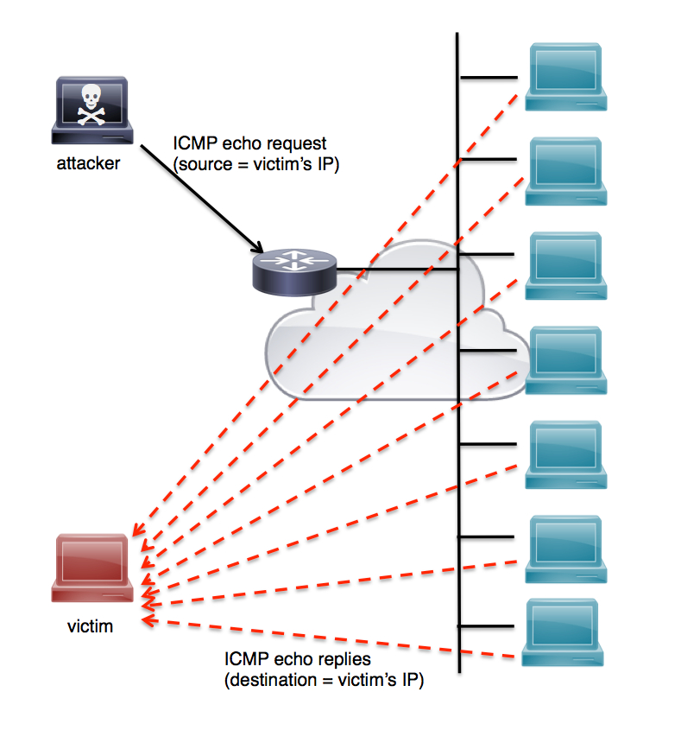
ICMP flood
<number>

Slide 5
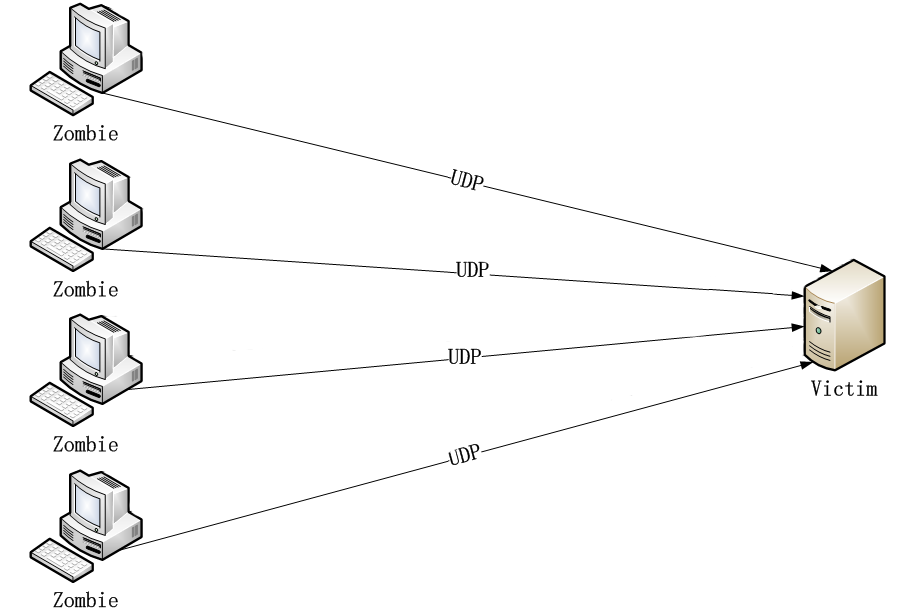
UDP flood
<number>

Slide 6
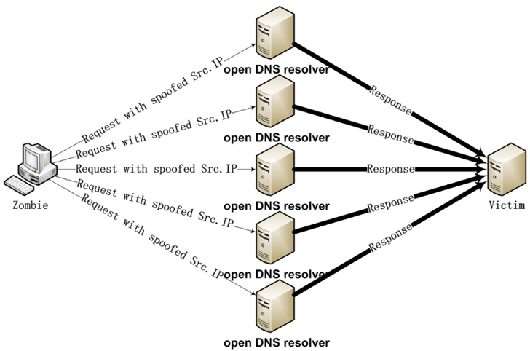
DNS amplification
<number>

Slide 7
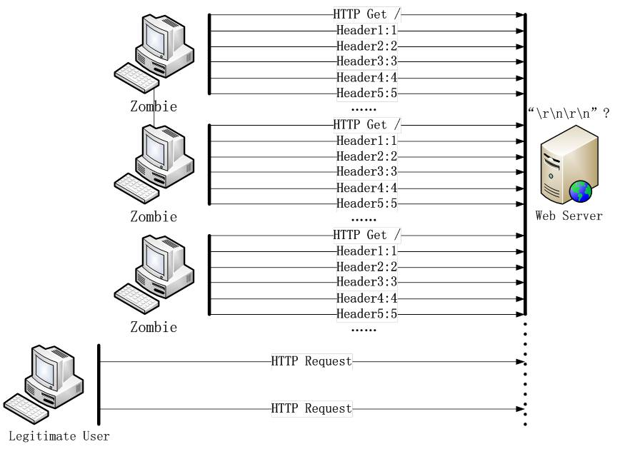
Slowloris
<number>

Slide 8
Thank you!
<number>

