Slide 1
AM TLD Registry System I.Mkrtumyan , H.Dadivanyan ISOC AM
ISOC Annual Meeting, Yerevan, Nov. 7, 2012
1

Slide 2
Internet Society Armenia (ISOC AM) is AM TLD manager and Registry
2

Slide 3
Juridical base of ISOC AM activity as country ccTLD
Accountability agreement on .am with ICANN
Letters of Exchange on .հայ with ICANN
Memorandum of cooperation with MTC RA

Slide 4
Country ccTLD DNS servers stability and resilience
As a country ccTLD ISOC AM’s main task is the stability and resilience of the country DNS servers. We have an accountability agreement with the ICANN for .am and exchange of letters on .հայ domains
How are we achieving that?
Constant upgrade of DNS servers hardware and software.
Having the second instance of anycast DNS servers installed in the ASNET-AM,

Slide 5
Country ccTLD DNS servers stability and resilience
Both instances are online, sharing the load,
Uninterruptable power supply including power generator
Instances are placed in different part of the city making disaster recovery easier.
DNSSEC - IPv6 - DNS RRL (Response-Rate-Limiting)

Slide 6
Reliability of the DNS service of Armenia
Two high-speed independent Internet providers, Arminco and ASNET-AM, each of them is multihome.
6

Slide 7
Root servers in Armenia
K, L, I, J-root servers The choice was L or K, because one is managed by ICANN, the other by RIPE.
L-root server was installed in Vivacell-MTS, so we decided to install K-root. Do Armenia need 4 root servers? We were monitoring local root servers and noticed that at least one was inaccessible some time. Besides that all of them are hosted by commerce organizations. We consider that it will be good to have a root server hosted by a non-for-profit organization. So we decided to host our own server for the country.
7

Slide 8
DNSSEC
DNSSEC – introduced in July 2011
8

Slide 9
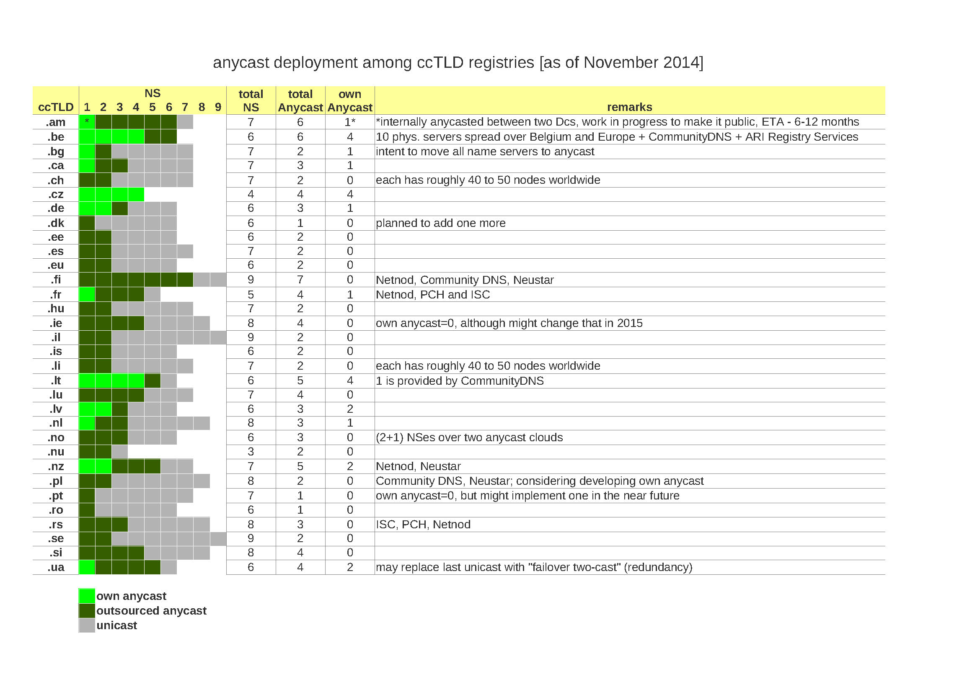
9

Slide 10
Community DNS server
CDNS supports about 68% of the whole Internet domain names
10

Slide 11
AS Number
ISOC AM has an AS 51090
It is necessary for:
Multihoming
Independence from ISPs
11

Slide 12
Country DNS IPv6 readiness
DNS services are IPv6 ready since 2006
12

Slide 13
AM Ripeness
Country IPv6 RIPEness We explain to LIRs the advantage of being IPv6 ready and help when it is needed .
13

Slide 14
In order to earn the first star, an LIR must have received an IPv6 allocation. Additional stars can be earned by registering a route6 object in the RIPE Database, setting up reverse DNS and announcing the prefix

Slide 15
Armenia connections to the Internet
Armenia is connected to Internet by fiber-optic cables via Georgia.
15

Slide 16
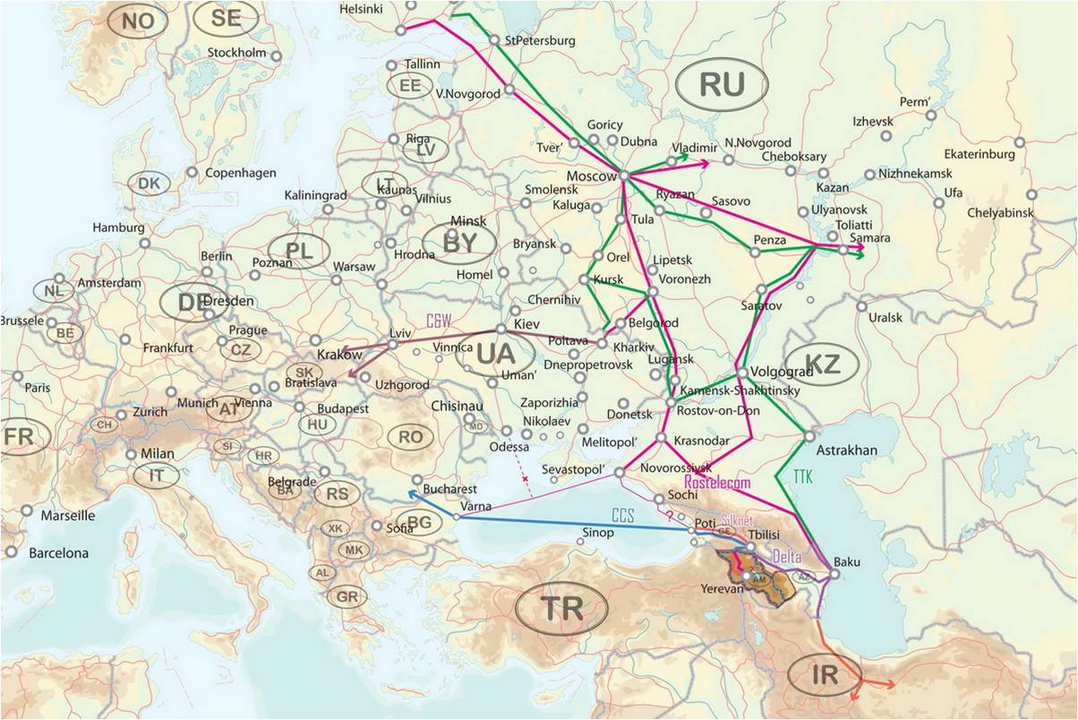
Backbones Around Armenia
(A.Kipchatov, IP backbone around Armenia)

Slide 17
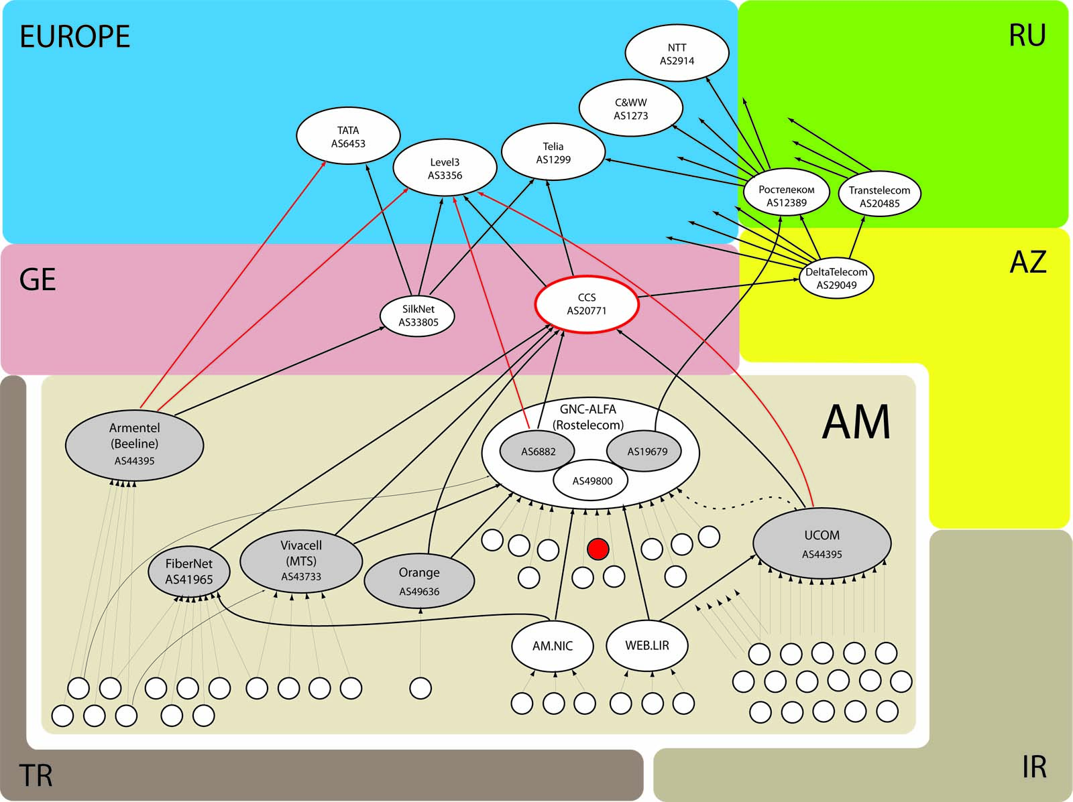
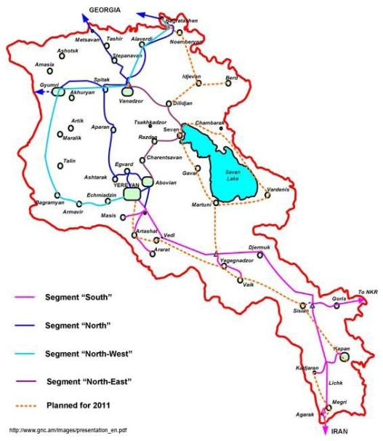
Backbones Around Armenia (A.Kipchatov, IP backbone around Armenia)
RTT from RU: 1. 45ms (Baku)
2. 85ms (Ams)
3. 35ms (Poti?)
GNC
External connectivity is provided through GE only but have variability…

Slide 18
AMNIC public services
DNS
Whois
WWW
Other services: e-mail, NTP (Stratum1), K-root, cDNS, RIPE Atlas

Slide 19
Datacentres
Server per service - virtualization
Database streaming replication
Internal anycasting
Backup to opposite DC

Slide 20
Upstreams
Multihomed, with large capacity
Connected to local exchanges
Native IPv6

Slide 21
ArmIX
- ISOC AM is a co-founder of ArmIX
ArmIX provides excellent connectivity of DNS servers, K-root and Registry to all local major providers. The setup of a switch connecting ArmIX to AMNIC datacenter is in process.

Slide 22
Plans
- IDN ccTLD
- Universal Acceptance
- Increase the security of the Armenian
web space - ENOG - Annual IGFs

Slide 23
Thank you!

