Slide 1
The Internet In Jordan Opportunities & Challenges
Khalid Samara
RIPE NCC Levant Regional Meeting
April 25, 2016
Beirut
Notes:
Introduction before I go through the slides in details i would like to thank you for this great chance to talk and meet with you here , as It is a pleasure to join this extraordinary meeting.
i will try to address some concerns , experiences , challenges & opportunities shared across the region, for JORDAN in specific , and about information & communications technology (ICT) and about Internet in specific .
my friends,
in jordan and Only ten years ago, pioneering companies were still putting down roots; many others did not even exist. Today, Jordan has more than 2.2 billion-dollar ICT industry, with expanding domestic, regional, and global positions. Yahoo's acquisition of Maktoob is only one sign of the high value placed on the capacity we have created.
Across the industry, success is supported by a flow of new talent from Jordan universities and new partnerships at home and abroad. Today, the one percent of our workforce involved in ICT contributes 14 percent of Jordan GDP. Just imagine the impact when our ICT workforce grows to five percent.
ICT sector stands as a model of enterprise, showing what people can achieve when they work with conviction, passion, focus and ambition. However ICT sector has helped to alter the cultural perception of entrepreneurship throughout our country and our region.
My friends,
This industry has achieved what it has, against a backdrop of sharp economic and political challenges to our world. Regional conflict has been a major disrupter of development.
So We need to work together to keep pushing for the region's economic future. That requires a new level of engagement; pooling the resources and expertise of government, business, education, the media and more.
However To build on strength, we need to keep asking the tough questions:
Is government doing enough to promote entrepreneurship?
What more can all our institutions do to support productive risk-taking and innovation?
What are the most effective ways to create, sustain, and keep industry talent?
And also How can we expand access to the opportunities afforded by this sector?
However we will ty to address some of these opportunities on this presentation ----

Slide 2
INTRODUCTION
Jordan has actively opened its telecommunications sector by easing government restrictions and limitations to network providers.
Internet penetration has increased tremendously.
But the Internet phenomenon is not without challenges despite its benefits to the Jordanian economy and productivity.
Notes:
As other countries on the region Jordan penetration has increased during the last years tremendously, we will go through the details on the coming slides,
However , After understanding the great role of this sector, and how internet make our life easier , Jordan governments tried to actively open ICT sector by easing government restrictions & limitations to network providers and internet services providers in Jordan.
On the other hand and despite the benefits of internet and this sector in our life; we know that there are still a lot of challenges exist and we will try to cover some of them on this session.

Slide 3
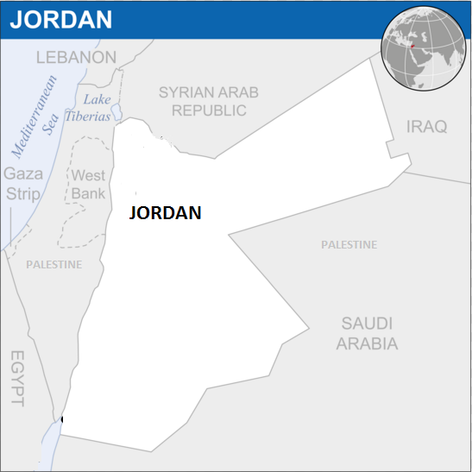
JORDAN IN BRIEF
• Capital: Amman
• Population: 7.73 million (2015)
• Religion: Islam (92.7% Muslims)
• GDP: USD35.77 billion (2014)
• Diversified economy:
• Service sector: 64.7% (2014)
• Government (19.5%)
• Finance, real estate (18.1%)
• Manufacturing (16.6%)
• Transport & communication (12.2%)
• Relies heavily on foreign aid
• Since 1999, focus on:
• economic stabilization
• market liberalization
• Reducing size of the government
• Full liberalization of the telecom sector,
• Increased no. of licensed operators
• Increased competition
• Low prices
• Higher broadband penetration
Notes:
Jordan's Strategic location at the heart of the Middle East has made it a political and economic crossroads for thousands of years .
today, Jordan is home to a rich blend of different ethnicities. ,
however the number of population more than 7.73 million ( and this is one of the main challenges that we have nowadays ) also the gross domestic public is 35 billion dollar ,
As mentioned on the this slide the service sector has 64.7% also transport & communication with 12.2%.
Unfortinattly ,, Jordan still relies heavily on foreign aid !
And to cover the gaps on the budget focusing on telecom sector by increasing number of licenses for the operators , increased competion and also reducing the size of government and follow a lot of other steps and plans are some actions made by government of jordan during the last period .

Slide 4
Overview
Jordan has traditionally been a regional leader in developing, adopting and utilizing information and communication technology
Jordan has a highly developed communications infrastructure
Jordan was one of the first Arab countries to introduce communication and information technology to the economy
Mobile broadband network download and upload speeds in Jordan are slightly above the average in Middle East and Africa (MEA) countries
Notes:
Nowadays Mobile broadband network download and upload speeds in Jordan are slightly above the average in Middle East and Africa (MEA) countries, as Jordan Jordan has a highly developed communications infrastructure on both public and private sectors and was one of the first Arab countries to introduce communication and information technology to the economy.
Also Jordan has traditionally been a regional leader in developing, adopting and utilizing information and communication technology
So lets see some stats about internet in Jordan

Slide 5
INTERNET PENETRATION IN JORDAN
Year | Users | Population | % Pop.
2000 | 127,300 | 5,282,558 | 2.4 %
2002 | 457,000 | 5,282,558 | 8.7 %
2005 | 600,000 | 5,282,558 | 11.4 %
2007 | 796,900 | 5,375,307 | 14.8 %
2008 | 1,126,700 | 6,198,677 | 18.2 %
2009 | 1,742,000 | 6,269,285 | 28.1 %
2010 | 2,324,000 | 6,407,085 | 38.0%
2012 | 4,260,000 | 6,508,887 | 67.0%
2015 | 5,700,00 | 6,623,279 | 86.1 %
Internet users: 5.7 million
86.1% of the total population 2015
Internet users: 6.2 million - June 2015
The growth of Internet users outpaces the growth of the population
More growth expected with the launch of new technologies 3G,4G Fiber, MW etc.
3 Main ISP & Telecom Provider:
(Zain ,Orange ,Umniah)
Notes:
Here we can see on the this table some stats & numbers about Jordan internet penetration
between the year of 2000 and 2015, starting from 127k internet user in 2000 and reaching more than 6.2 million user in 2015 which make it clear that The growth of Internet users outpaces the growth of the population! , as the internet penetration exceeds 86% during the last period!
On another hand after the lunch of the new mobile and backhauling technologies more growth expected during the coming period. and something to be mentioned here that Jordan has 3 main telecom and internet providers -- Orange , Umniah and zain) and all of them already lunched 3G and 4G mobile services , in addition to the other legacy and new corporate services such as :
fiber to the home
ADSL
Mw
Mpls services
And a lot other services which serve the local market.

Slide 6
History of Telecommunications developments in Jordan
Notes:
In this slides we have quick brief about the history of telecommunications development in Jordan , starting in 19-71 by establishing telecommunications corporation as government controlled entity ;;the main responsibility of this entity is to provision the different telecom services at that time . And this entity controlled this sector until 1993 when the private sector was allowed to start and invest in telecommunication sector.
Then after that in one year in 19-94 also the first mobile circular license in Jordan granted.
In 19-95 telecommunications regulatory commission (TRC) was established with several tasks and missions related to the telecom sector and how to develop it in Jordan.
In 2000 Jordan became a full member in world Trade organization , which was Avery good thing and lead to fully liberalization of telecom sector by the end of 2004!
However in 2009 telecommunications regulatory commission granted a third generation 3G license to one of the mobile operators in Jordan.
Finally in 2014 first 4G license was granted to one of the telecom operators followed by two other licenses in 2015 , and now we have three operators running 3G & 4G mobile services in different frequencies and capacities;
and this for sure will lead to increase the total number of capacities and throughput and QOS that would be provided to the customers and end users ,
On the other hand the competition that has been created by granting the three main operators the licenses to implement new technologies. Will lead for better services that will be offered to the customers with best prices (from end users wise not from ISP wise).

Slide 7
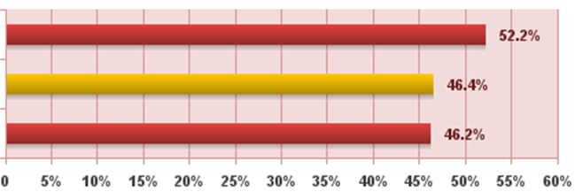
Penetration in Middle East Nov 2015
Middle East
World Avg.
Rest of The World
Penetration Rate (% Population)
Notes:
Looking at this slide we have the graph about the penetration in middle east compared with the rest of the world , as we can see the average penetrations rate in the world is 46,4% why in middle east country is about 52.2% which mean that middle east countries have a higher penetration rate that the other regions.!
More numbers are available in the next slide as we can see on the next table :-

Slide 8
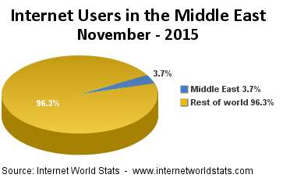
Penetration in Middle East Nov 2015
Internet Users
MIDDLE EAST vs REST OF THE WORLD
 | Population (2015 Est.) | Pop.% Of world | Internet users 30-Nov-15 | % Population (Penetration) | Internet %Users | Facebook 15-Nov-15
Total Middle East | 236,137,235 | 3.30% | 123,172,132 | 52.20% | 3.70% | 49,400,000
Rest of the World | 7,023,765,008 | 96.7% | 3,243,087,924 | 46.20% | 96.30% | 1,465,804,150
World Total | 7,259,902,243 | 100% | 3,366,260,056 | 46.40% | 100% | 1,515,204,150
Notes:
As we have here number of internet users in Middle East is around 124 million users while the total number of population in middle east around 237 million , also Middle east has a 3.7 % of the total world internet users ,
Again as mentioned on the previous slides around 52.2% penetration rate in ME . which gives again an indicator that middle east has higher penetration rate that the rest of the world ,
But .. what about the QOS and the BW that provided for middle east users ?

Slide 9
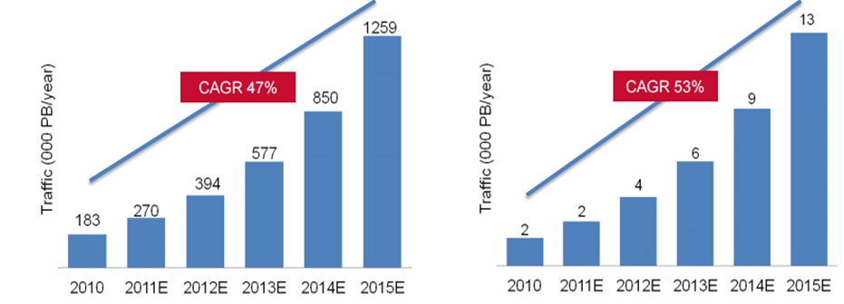
Penetration in Middle East Nov 2015
Internet Traffic Keeps growing rapidly, but Middle East Growth will only slightly outperform global growth !
Global Internet traffic
Middle East Internet traffic
Notes:
Compound Annual Growth Rate
As we can see here even middle east has higher penetration rate but Middle East Growth will only slightly outperform global growth from internet traffic wise !
And there are a lot of reasons for that, one of the mean reasons is that Regional and international connectivity to the Internet is both complex as we no regional backbones which make it costly in middle east and also for Jordan as Jordan part of this region .

Slide 10
INTERNET USERS -2015 JORDAN vs Middle East
Middle East | Population ( 2015 Est. ) | Users, in Dec/2000 | Internet Usage 30-Nov-2015 | % Population (Penetration) | Internet % users | Facebook 15-Nov-2015
Bahrain | 1,346,613 | 40,000 | 1,297,500 | 96.4 % | 1.1 % | 700,000
Iran | 81,824,270 | 250,000 | 46,800,000 | 57.2 % | 38.0 % | n/a
Iraq | 33,309,836 | 12,500 | 11,000,000 | 33.0 % | 8.9 % | 11,000,000
Jordan | 6,623,279 | 127,300 | 5,700,000 | 86.1 % | 4.6 % | 4,100,000
Kuwait | 3,996,899 | 150,000 | 3,145,559 | 78.7 % | 2.6 % | 1,900,000
Lebanon | 4,151,234 | 300,000 | 3,336,517 | 80.4 % | 2.7 % | 2,600,000
Oman | 3,286,936 | 90,000 | 2,584,316 | 78.6 % | 2.1 % | 1,200,000
Palestine (West Bk.) | 2,785,366 | 35,000 | 1,800,000 | 64.6 % | 1.5 % | 1,800,000
Qatar | 2,194,817 | 30,000 | 2,016,400 | 91.9 % | 1.6 % | 1,700,000
Saudi Arabia | 27,752,316 | 200,000 | 18,300,000 | 65.9 % | 14.9 % | 12,000,000
Syria | 22,878,524 | 30,000 | 6,426,577 | 28.1 % | 5.2 % | n/a
United Arab Emirates | 9,445,624 | 735,000 | 8,807,226 | 93.2 % | 7.2 % | 6,300,000
Yemen | 26,737,317 | 15,000 | 6,029,265 | 22.6 % | 4.9 % | 1,700,000
Gaza Strip | 1,869,055 | n/a | see Palestina | n/a | n/a | see Palestina
TOTAL Middle East | 236,137,235 | 3,284,800 | 123,172,132 | 52.2 % | 100.0 % | 49,400,000
Notes:
On this table we can go through more details about Middle East countries and numbers for internet users and penetration rates for all countries on this region ,, for Jordan total number of user in Jordan not exceed 4.6% of the total number users in middle east . and this information counted by the end of nov in 2015.

Slide 11
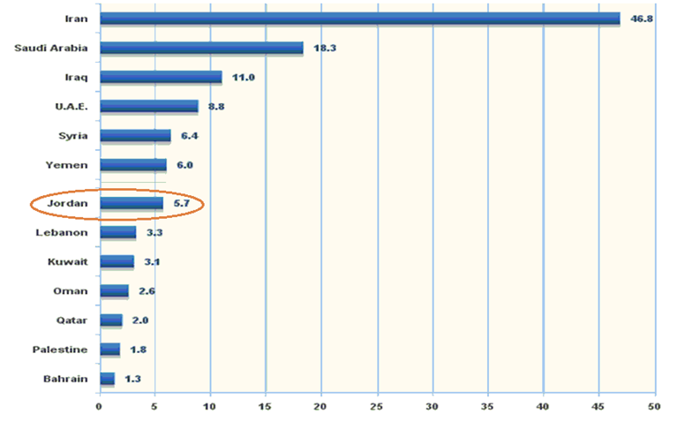
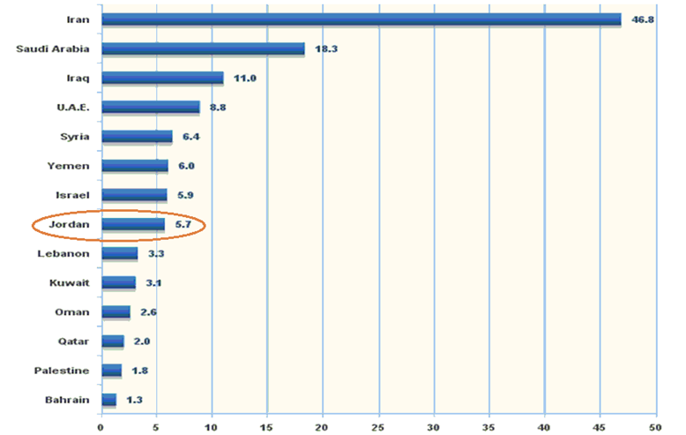
Middle East Users East per country 2015
Million of internet users
Notes:
Also here we can see in this graph the total number of internet users for all middle east countries ,
Iran has the highest number of internet users of 46.8 million users , while the 2nd is one is KSA with 18 million users then uae , Syria, yemen and then jordan with more thatn 6 million users , and finishing with Bahrain with 1.8 million users ,,
however it is clear that the numbers sometimes related to the population in each country, and this is in general.

Slide 12
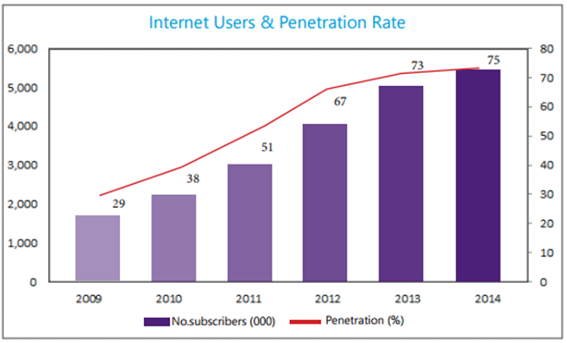
Internet Penetration in JORDAN Internet users Internet related to users of the internet service during the period ( 2009-2014)
Notes:
We will go more details about internet penetration in jordan starting with the
127k internet user in 2000 and reaching more than 6.2 million user in 2015 which make it clear that The growth of Internet users outpaces the growth of the population! , as the internet penetration exceeds 86% during 2015!
again The growth of Internet users outpaces the growth of the population!
However and going to the next slide

Slide 13
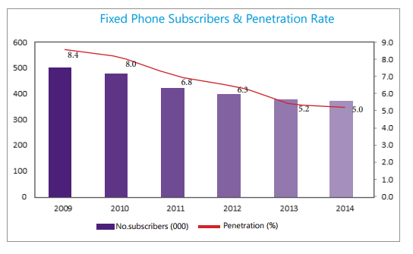
Internet Penetration in Jordan Mobile & Fixed subscription
Active Mobile Subscriptions (Q4-2015)
Notes:
We can see more statics about mobile and fixed subscription in jordan by the main three operators in Q4 in 2015 , zain has the highest number of mobile users with 4.860 million users then orange comes with 4.534 million users then umniah with 4.338 million user , this is for the mobile users in both pre-paid and post-paid users where in jordan pre-paid subscriptions usually 12 times of post-paid subscriptions
Regarding , the fixed phone subscriptions and penetration rate also it is clear that we have a decrease of the numbers of the fixed lines while the mobile is increasing , , the penetration rate for fixed users decreases from 8.4 % in 2009 to 5% in 2014!

Slide 14
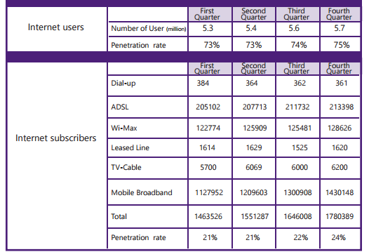
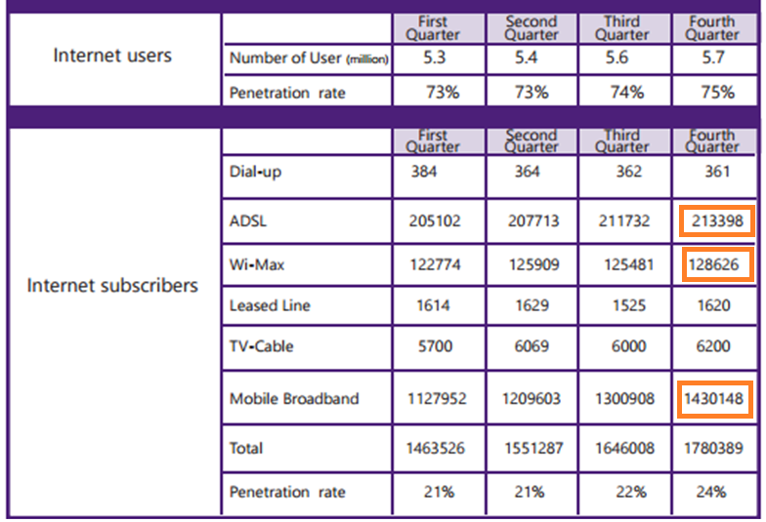
Internet Penetration in Jordan Per service - Quarterly
Notes:
This table show the different type of internet services that provided from the different Jordan ISP operators such as (dial up , ADSL, WiMax, Mobile Braodband , and Leased Line ).
However the highest number of subscription come from mobile broadband users most of them for 3G & 4G subscriptions, with the total number of 143 million subscriptions then adsl users with 214 k subscriptions then WiMax 129K subscriptions . Then the other services.

Slide 15
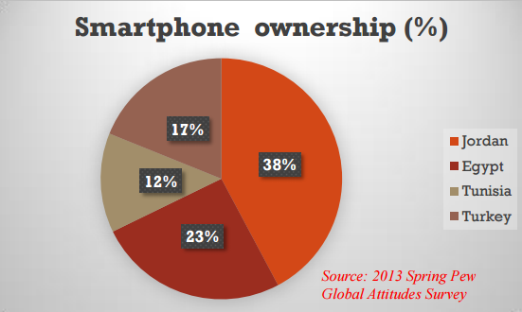
Internet Penetration In JORDAN Smart Phones
Internet penetration further heightened with the development of smart mobile phones.
Jordan is among the countries in the Middle East with high smartphone ownership.
Notes:
Also looking at another stats regarding the internet market in jordan and especially smart phones market as the highest number of subscriptions and internet connections comes from mobile service, and as Internet penetration further raise with the development of smart mobile phones. Jordan consididred among the countries in the Middle East with high smartphone ownership with 38 % .
egypt comes with the 2nd place with 23% then terkey 17% & tunsia 12%

Slide 16
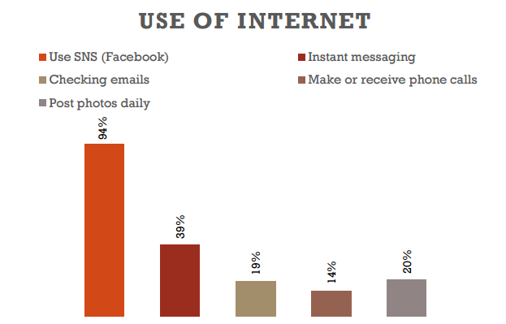
Use of Internet In Middle East
Source: Media Use in the Middle East (2013)
Notes:
Again Looking the graph here we can notice that
94% of users in Middle East use the internet to reach social media services, while
39% for instant massaging.
19% used their mobile to check there emails.
14% for phone calls
20% for post photos daily

Slide 17
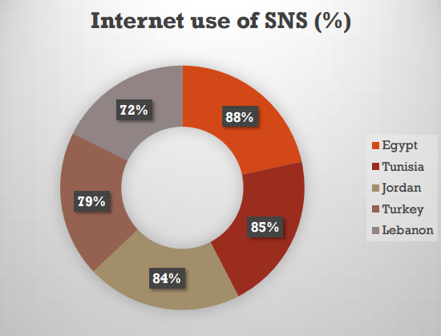
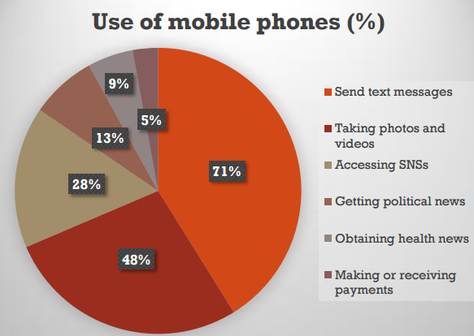
Smartphones Usage in Jordan
Notes:
Also looking briefly in the types of internet services that Jordan people use internet for ,
we can see on the graphs that Jordan in the 2nd place for using internet for social media with 84% after Egypt . also jordan people usually used there mobiles mainly to send text messages with 71% then taking photos & videos with 48% then accessing Social networks with 28% , and lowest rate for making payments online!
Seems people don’t trust any finicial payment over the internet ☺

Slide 18
Total Jordan Subscribers
Sector | 2013 | 2016
Internet users | 5.30 | 6.5
Fixed-line telephony | 0.38 | 0.35
Mobile phone | 10.31 | 14.20
Overview Jordan Subscribers to telecoms services (million): (e)
Notes:
As a summary the total number of internet users increasing and the mobile subscribers also increasing while the fixed lines decreased every year as we can see on the summry table here during the last 3 year!

Slide 19
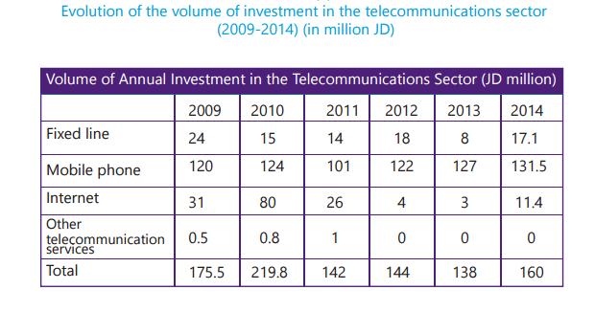
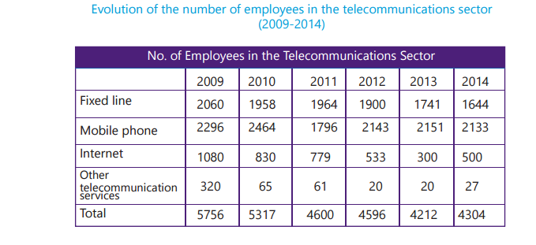
Investment in Telecommunications Sector
Notes:
As mentioned in jordan TRC telecommunications regulatory commission report ; the total number of investments in Jordan Telecommunication decreased in all sector except mobile networks due to the new implementations of new mobile generation networks. Which increased from 120 million JD to more than 131.5 million JD
However the overall investment in telecommunications sector decreased from 175.5 million Jd to 160 million JD.
other issue that need to be taken in consideration which may be considered a negative indicator that the total number of employees in internet and telecommunication sector decreased yearly ! and in all telecommunications sectors!
In 2009 the total number of employees was 5756 and started to be decreased yearly to be 4304 in 2014! Instead of increasing it decreased and keep decreasing !
It is realy a negative indicator and realy need to be taken in consideration !

Slide 20
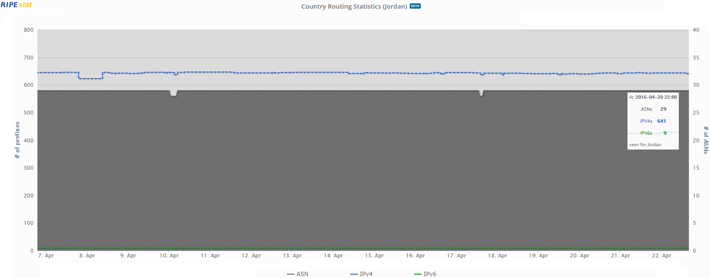
Internet In Jordan IP assignments
Notes:
In this slides we will have a look at the internet in Jordan which related to the total number of IPv4 & IPv6 assignment and the total number of Autonyms numbers reserved for Jordan
As we can see from the ripe database here . we have total number of 33 ipv4 ASN reserved for JRDAN with 649 total number of IPv4 subnets
On the other hand we have just 7 ASN ipv6 with total number of 10 subnets.

Slide 21
Opportunities for internet connectivity success
Latest Mobile & backhauling technologies
Latest transmission networks with high capacities in both governmental and private sectors
general government trend to increase & facilitate telecommunication and information technology easing government restrictions and limitations to network providers.
Three main internet & telecommunication services providers
(Zain , Orange, Umniah)
Notes:
The number of Internet end-users in Jordan has increased sixfold in the last seven years., According to the Telecommunications Regulatory Commission website, there are now 5.9 million users.
However, Jordan is still looking for better services and a larger increase in the number of Internet end-users….
According to the all information shown above we have a lot of things that would help to build and increase internet sector in jordan some of them like:
We have latest mobile and backhaul networks with Avery highly capacities distributed all over the kingdom,
also we have Avery experienced people expert in information and telecom sector , for main mobile & ISP operators they have Avery disrupted MPLS and transmission networks that used to carry the new mobile technologies and different type of other services , ,,,, this is from private sector ,, from public and government sector we have national broadband network NBN that also cover all Jordan cities and centers with high capacities .
Also the government aimed to make sure to make any investment in this sector easy and to make internet available for all people by both private and public projects. Also encouraging any related internet project even in small or enterprise sectors which may be also help in development Jordan community!

Slide 22
Major connectivity obstacles in Jordan
High prices and low market maturity decelerate broadband penetration in Jordan.
Regional and international connectivity to the Internet is both complex (no regional backbones) and costly in Jordan.
Mass broadband adoption is the result of the availability of content and applications that are pertinent to internet end-users in their native language, and contributes in turn to the promotion of increased productivity in the economy as a result of this mass adoption.
The development of digital Arabic content on the Internet to become the main medium for the exchange of information between end-users in their native language.
Notes:
One of the main obstacles in Jordan is :that the Regional and international connectivity to the Internet is both complex as no regional backbones and costly in Jordan which lead
To High prices
and also low market maturity decelerate broadband penetration in Jordan .
Another issue need to be taken in considerations is the development of digital Arabic content on the Internet to become the main medium for the exchange of information between end-users in their native language.
Security awareness and internet misuse need to be also handled by both private and public sector in order to take the right benefit from implementing internet and technology in all other fields in Jordan.

Slide 23
Thank You www.Menog.org

