Slide 1
Transforming Education Through IT
RIPE NCC Levant Regional Meeting
Dr. Yousif Asfour
April 25, 2016
American University of Beirut

Slide 2
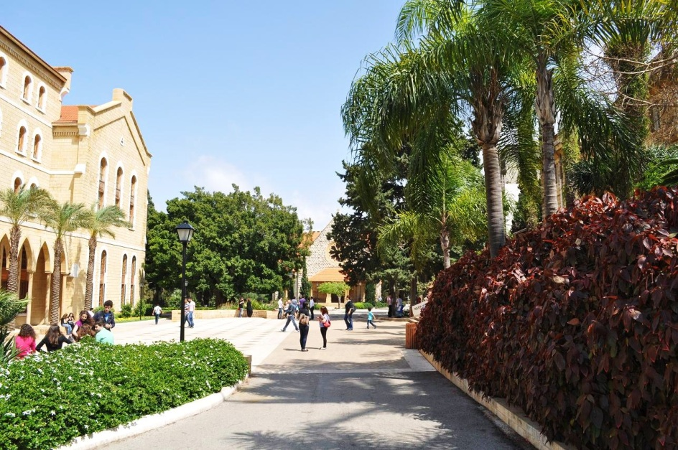
The mission of
IT @ AUB
is to be a strategic partner
with
the academic units to
help transform
teaching, research ,
student life & patient care
at AUB

Slide 3
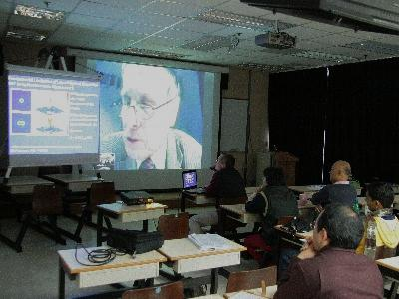
So that …
… a lecturer in New York can connect to a classroom in Beirut to teach

Slide 4
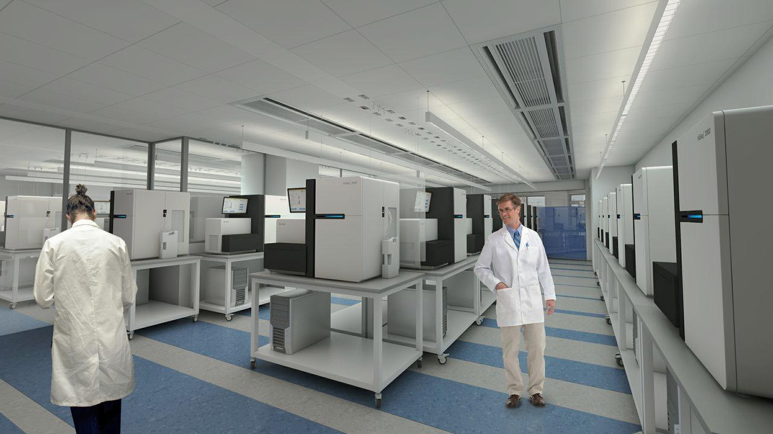
… and a researcher at the lab can connect his genome sequencer to the HPC at the data center to analyze
an ant

Slide 5
… and a researcher at the lab can connect his genome sequencer to the HPC at the data center to analyze
an ant
… and doctors can collaborate with each other remotely

Slide 6
… and a physicist on campus
can connect his laptop to CERN
to discover the next new quark

Slide 7
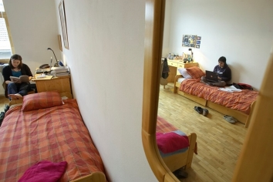
… and a student at her dorm connect to a server on the web to invent the new Facebook

Slide 8
… and a Post Doc on the beach can connect her iPad to the AUB storage bank to analyze fish pictures

Slide 9
… and a student at a coffee shop can connect to her roommate to finish her homework!

Slide 10
We are shifting our focus
from
managing
infrastructure

Slide 11
… to creating research and teaching services

Slide 12
We are
transforming our role from being service providers …

Slide 13
to become service brokers

Slide 14
We a are transforming our staff from mostly engineers

Slide 15
… to mostly
consultants and service managers

Slide 16
We are transforming our environment…
…from a “Castle & Moat” model…

Slide 17
… to a connected community model …

Slide 18
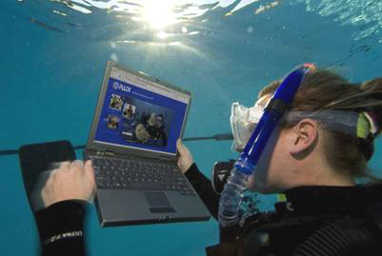
… by creating an (Any)⁶ infrastructure
(connect any one, from any where, through any device, at any time, to any resource, to do any thing)

Slide 19
IPv6 security and flexibility …
Abundance of addresses
Automated configuration (SLAAC)
Direct node-to-node addressing
Mandated encryption and security
Individualized IP addresses for students
… make it possible to build the
“Free Flowing City” and the “Any⁶” infrastructure

Slide 20
… making it easier to provide innovative research and education services ...
EduRoam
Federated services
Expanded international connectivity
HPC and specialized computing
Cloud services
Smart campuses

Slide 21
We are shifting our focus …
Business Analysis
Consulting
Development
Integration
Operations
Management
…and it all depends on flexibility

Slide 22
22

